Slide 1
EUOS Standards Academy – Training the Next Generation of ICT Standards Experts
Webinar, July 6

Slide 2
Today’s agenda
EUOS Standards Academy
Training the Next Generation of ICT Standards Experts
Time | Topic | Speaker
11:00 – 11:15 | Opening & the role of the Academy for Education in Standardisation | Brian McAuliffe
11:15 – 11:25 | Education in Standardisation: the EC perspective | Thomas Reibe
11:25 – 11:35 | Education in Standardisation form an academic point of view | Ivana Mijatovic
11:35 – 11:45 | Why Standardisation Engagement and Education is important for your Industry | Martin Chapman
11:45 – 12:00 | Q&A | All

Slide 3
StandICT.eu & EUOS
StandICT.eu 2023 kicked off on 1st September 2020. It is an EU framework project H2020 Coordination and Support Action with the central goal to ensure a neutral, reputable, pragmatic and fair approach to support European and Associated states presence in the international ICT standardisation scene
https://www.standict.eu/

Slide 4
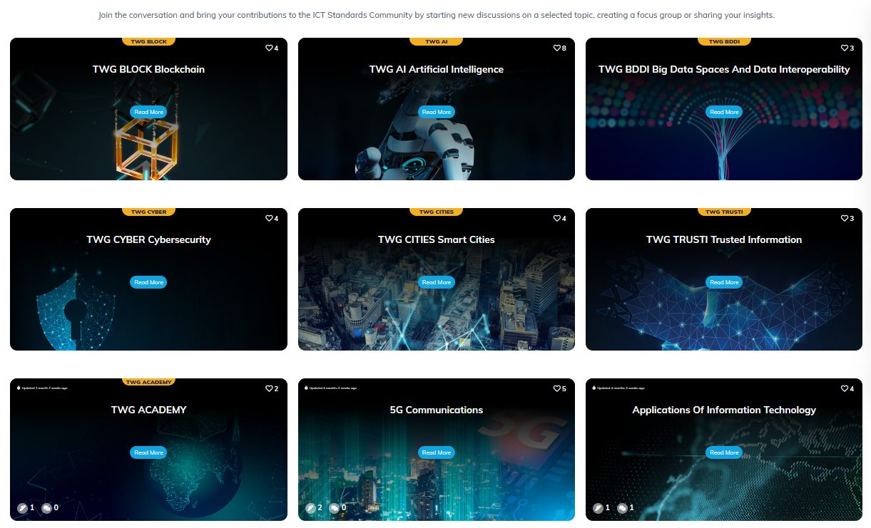
EUOS TWGs
Technical Working Groups x 6
(AI, Blockchain, Cyber, Smart Cities, Trusted Info, Data Spaces)
Standards Academy

Slide 5
Academy publications
.. the first of a series of Landscape Reports on ICT standards, Landscape of AI Standards a palpable, go-to reference, providing an overview of the diverse array of global standardisation work underway in Artificial Intelligence and the various organisations behind it. This information will be continuously updated and evolve via the “EUOS – Observatory for ICT Standardisation” a database powered by StandICT.eu 2023 to cover the wide-range of topics identified in the Rolling Plan for ICT Standardisation, and will ultimately result in the release of a dedicated Gaps Analysis Report for each theme.
https://www.standict.eu/news/birds-eye-ict-standardisation-ai

Slide 6
TWG Academy: Our remit
Scope
Education on the why and the how of standards & standardization
Terms of reference
Institute an Expert Group for the term 2021 - 2023
Curate and make available educational and training materials on the standardization process
Leverage existing material – not creating new
Consider all types of standards development organisations and methods
There is a role for all
Consider all stakeholder types
Policy makers, industry, academia, societal orgs
Recommend a set of deliverables and associated timelines
Report progress to EAG on regular basis and present updates to StandICT workshops annually

Slide 7
Deliverables
Current planned deliverables
Catalogued repository of educational material
Papers, Presentations, Case Studies, Videos, Books, ….
Competency matrix
Policy Makers, Industry, Public Administrations, Academia, Societal Stakeholders, ….
Education pathways
Certifications/badges??

Slide 8
TWG Academy makeup

Slide 9
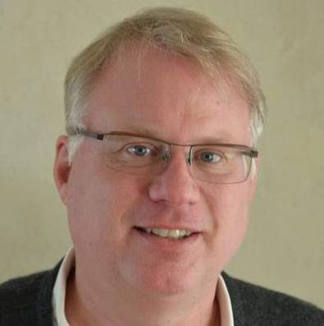
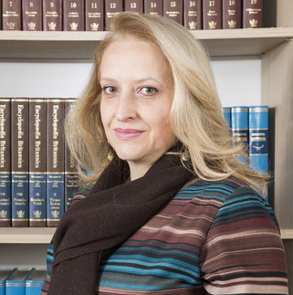
Today’s speakers
Thomas Reibe
EC DG CNECT
Senior Expert & StandICT.eu Project Officer
Dr. Martin Chapman
ORACLE
Senior Director, Standards & Compliance Policy
Ivana Mijatovic, PhD
University of Belgrade
Full Professor, Faculty of Organizational Sciences

