Slide 1
Bringing cloud, edge and IOT together: the role of standards & Synergies with RESEARCH PROJECTS
The European Cloud, Edge and IoT Continuum
Maria Giuffrida, Senior Research Analyst, Trust-IT
m.giuffrida@trust-itservices.com

Slide 2
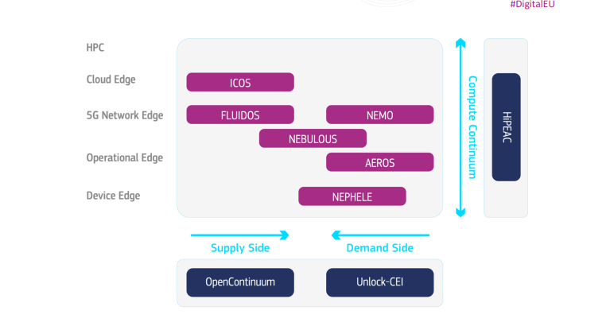
THE EUROPEAN CLOUD EDGE AND IOT CONTINUUM
methodology and standardisation of architecture across systems
current and emerging standards of key use cases
EUCloudEdgeIoT.eu aims to:
realise a pathway for the understanding and development of the Cloud-Edge-IoT (CEI) Continuum
promote cooperation between a wide range of research projects, developers and suppliers, business users and potential adopters of CEI
contribute to the coordination of a portfolio of projects in the CEI Computing Continuum funded under the Meta-Operating Systems for the Next Generation IoT and Edge Computing
support the definition of the large-scale pilots envisaged by the European Commission in line with the EU Data Strategy.
Partners

Slide 3
THE EUROPEAN CLOUD EDGE AND IOT CONTINUUM
Role of open source and standards for competitiveness
Roles and functions of each actor, including facilitators like SDOs, associations, multipliers
methodology and standardisation of architecture across systems
current and emerging standards of key use cases
Reports
Landscape
Ecosystem
Technology scope
Outreach
Adopter Events
Developer Events
OSS Governance
Engage
Embed
Develop
Validate
Strategic Liaisons , Open Source Engagement, Architecture inter-project Task Forces
Interoperability and readiness frameworks, pre-standardisation activities and needs
Partners
Perspectives
Use Cases
Routes to market
Key Actions
Synergies
Task Forces
Partnerships
Demand/Supply

Slide 4
The role of Open source and open standards for business and research
Contribute to the definition of a common open architecture and taxonomy for the CEI computing continuum
Guide research projects into making process-compliant contributions to Open Source
Train industry on definition of a long term Open Source strategy and governance
Investigate approaches to support standards through associated open-source implementations
Support computing continuum research projects on pre-standardisation initiatives
Identify the main CEI ecosystems and investigate the competitiveness implications for the European industry both at the vertical and horizontal level, including cross-cutting aspects like the role of open standards, open source, and synergies across sectors
Identify roles and required functions for large and small players, established actors and SMEs/start-ups, national and private initiatives in the ecosystem, identify and validate service requirements of key use cases.
Develop and refine important standards and interoperability frameworks by key facilitators enabled by the validated service requirements

Slide 5
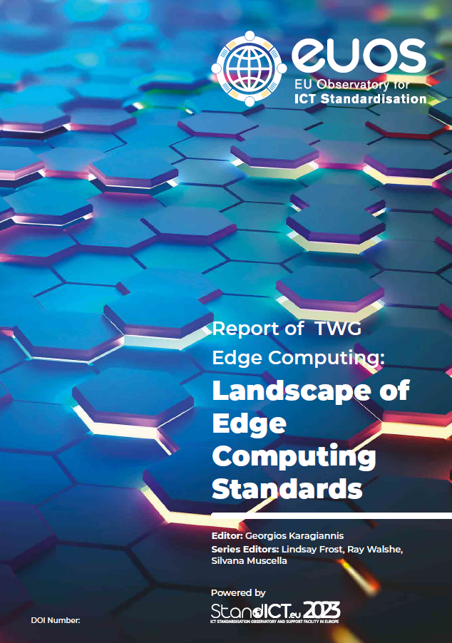
Technical Working Group -IIoT & EDGE: the mETHOD and «Legacy»
825 views
480 downloads
Objective
The TWG IoT (published) and Edge (soon online) reports represent a dynamic overview of documents and activities relevant to standardisation in IoT & Edge, also reflected in the EUOS Observatory that has mapped ICT standards more in general in connected areas such as AI, 5G, and Cloud Computing
Method
Aggregating, following the main subtopics, SDOs involved and characteristics of the documents, over 700 IoT and over 240 Edge specifications and documents on architectures, requirements, technical reports, reviews, white papers, guidelines, etc. in a way that encourages future extensions, re-use, cross-comparisons and re-classification according to various needs
Impact
This work helps identify gaps in the standardardisation where additional activity would aid deployment of technologies and interoperability within the EU and globally
This work constitutes a living (and continuously updated via the EUOS) legacy for anyone interested in these topics
Next steps
Key outcomes of the report, e.g. standardisation needs and gaps, to feed the discussion and work of some of the EUCloudEdgeIoT Task Forces
https://doi.org/10.5281/zenodo.7193435
Authors: Ray Walshe, Georgios Karagiannis, Noleen Campbell, Maria Ines Robles, Michelle Wetterwald, Orfeas Voutyras,, Antonio Kung, Lindsay Frost, George Suciu, Amelié Gyrard, Jens Gayko, Axel Rennoch, Edward C. Zimmermann, Marco Carugi, Amanda Suo, Carlos Valderrama, Richard Pitwon, Christine Perey, Kong Lingbo, Shen Bin, Samir Medjiah,
Thanks to the European Commission for their continued guidance and support: Thomas Reibe, Emilio Davila-Gonzales, Eddy Hartog and Max Lemke.

Slide 6
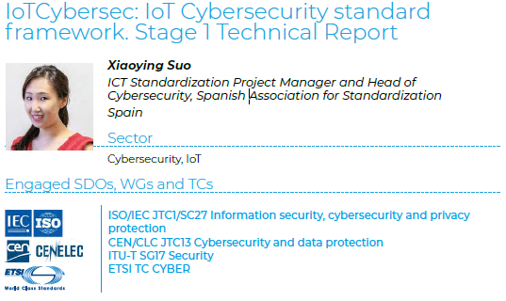
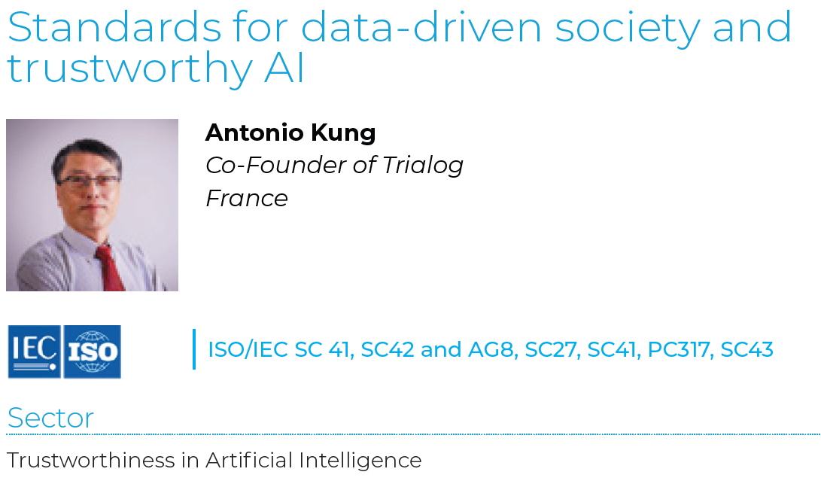
OnGOING synergies with standict.eu
EUCloudEdgeIoT Strategic Liaisions Task Force facilitates interactions with StandICT.eu and its ecosystem
StandICT.eu fellows working in the areas of Cloud, Edge, IoT
Contribution to gaps and standardisation needs definition in Cloud, Edge, IoT
In future, cooperation on emerging standards for use cases
StandICT.eu TWG experts and fellows to be involved in EUCloudEdgeIoT Value Chain Adopter Groups
StandICT.eu Funded Fellows in CEI: some examples

Slide 7
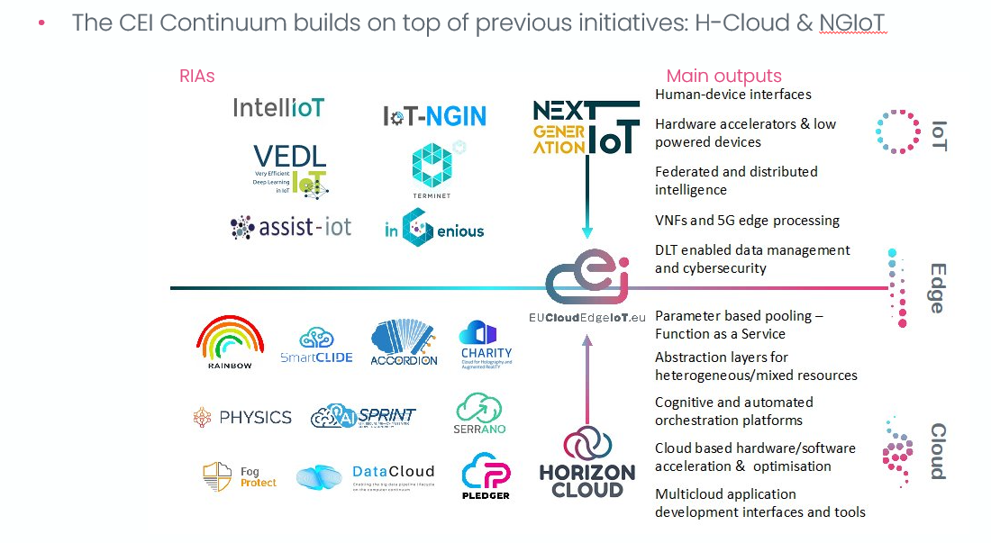
synergies with other key initiatives [1/2]
EUCloudEdgeIoT builds on top of previous initiatives: H-Cloud & NGIoT​…
Includes Roadmap for IoT deployment in Europe (also in standardisation)
…and will embed more (e.g. Cognitive Cloud, Swarm Computing)​
Includes Overview of Cloud Standards and Open Source Initiatives

Slide 8
synergies with other key initiatives [2/2]
Coordinates a portfolio of projects tasked with developing and trialling next-generation architectures that underpin the deployment of edge computing, distributed intelligence, federated microservices, collaborative IoT and tactile interfaces integrating holistically those enabling technologies such as DLTs and 5G, to reach consolidation of fragmented IoT verticals and the still disconnected research and technology domains
Current software technology landscape, covering key issues such as cybersecurity, uptake of open source, and trends in software lifecycle best practices which can also support the transition towards the CEI continuum
Standardisation support services for the revision of existing standards, the identification of emerging standards or the creation of new ones

Slide 9
Save the date for our next webinar Shaping the uptake of cloud-to-edge based services to support industrial use cases 6th February 2023, 15:00 – 16:00 cet
This webinar will present the activities towards the creation of an engaged community of Cloud-Edge-IoT adopters to help understand the requirements, also in terms of open source and standards, for the future uptake of such technologies
The webinar will open the first wave of Value Chain Adopter workshops to be held between mid February and mid March 2023 in 5 key sectors
Manufacturing
Agriculture
Health
Energy and Utilities
Transportation
Cloud computing, Edge computing and IoT can transform businesses across Europe. Are European organisations ready?
Discover more and register here

Slide 10
THANKS FOR YOUR ATTENTION!
Open Continuum
Unlock CEI

