Slide 1
Ray Walshe (DCU)
Director
EU Observatory for ICT Standards
Project Coordinator: Trust-IT Services

Slide 2
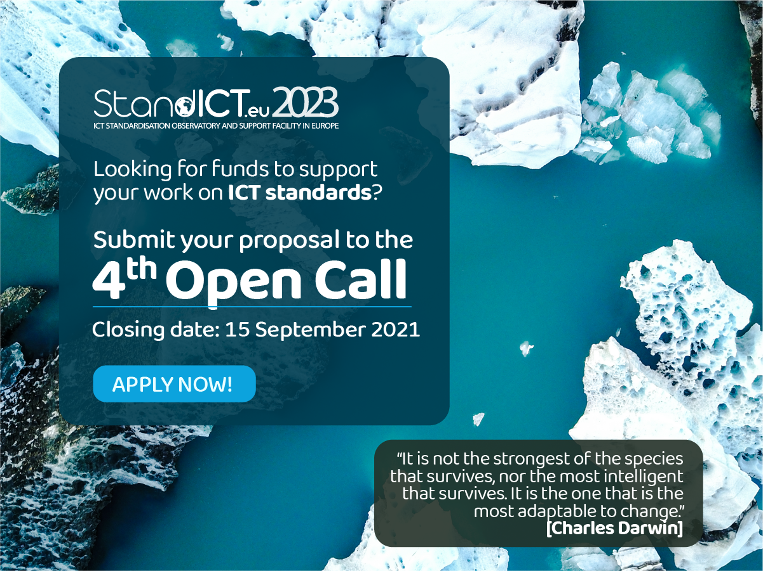
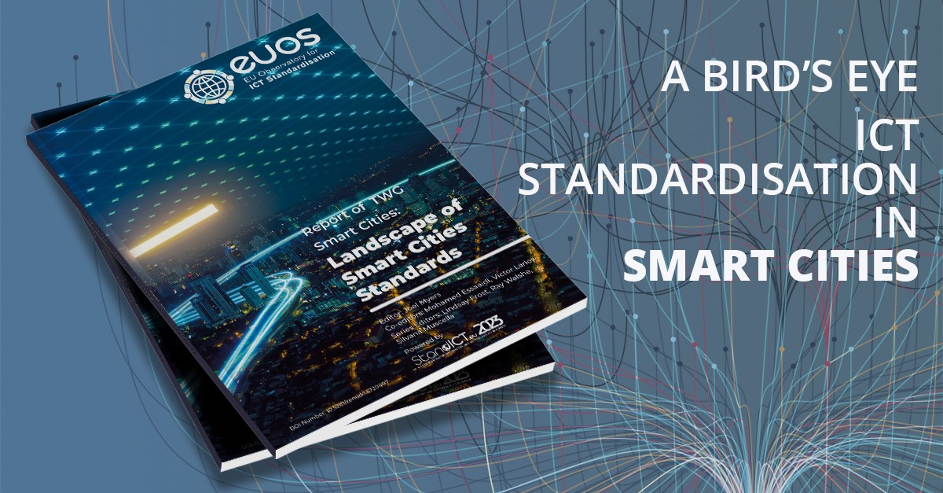
Key-Achievements of StandICT.eu 2023 so far
7 Open calls Completed
Open Call #8 now launched & runnning until 07 Nov ‘22
Functional Grants Platform for applications & evaluation process (58 contractualised EPEs)
9 Webinars on topical subjects (AI, Cybersecurity, EU ICT Policies, Trusted Information, Education in Standardisation, Blockchain)
16 Memorandum of Understanding signed with relevant players
Synergies with 56 Stakeholders
Participation to 33 third-party events + 9 SDOs meetings
EUOS Release (March 2021) + Publication of AI Landscape Report + Smart City Landscape Report + Trusted Information Report + Digital Twins Landscape Report
12 EUOS TWGs on key ICT domains to work on dedicated Landscape & Gap Analysis 4 Landscape Reports completed
More Landscape Analysis reports in release pipeline for 2022 (Robotics, IoT, Edge., Blockchain, Ontologies)
COMMUNITY 1484 registered users 3165 LinkedIn Followers 790+ Twitter Followers
Expert Advisory Group (EAG) members from SDOs, European Commission & Industry (20 members contributing to keep topic list updated)
4 Impact Reports released to disseminate the concrete outputs of fellows funded under Open Calls #1 to #4 4th issued in June 2022

Slide 3
Consistent number of proposals coming from applicants coming from SMEs and/or IT field as well as from Academia/Research
Cybersecurity, 5G,
Artificial Intelligence,
Blockchain & DLT proved to be yet the most popular topics.
A wide range of different topics tackled: e-Health; Semantics; Smart Grids; Smart Cities and more.

Slide 4
New Standards Developed/Revised in the StandICT.eu Fellowship Programme Context (1° - 2° - 3° - 4° Open Call)
As a result of the StandICT.eu received financial grant 57 applicants stated to have contributed to the development/draft of brand new Standards and 44 are currently working (or contributed) to setting-up new TCs, WGs, sub-committees or Focus Groups in renowned SDOs.
“Following the Fellows Impact Reports”, highlights a variety of evidence-based outcomes gained through the project’s second open call. The report puts the fellows themselves, all of whom are rightly experts within their own respective fields of ICT standardisation - under the spotlight and offers them the opportunity to speak about their work and the added-value they are contributing to standards efforts as awardees from their own perspectives.
IoT, Cybersecurity, 5G, Blockchain, e-Health, Quantum ,Artificial Intelligence,
Semantic Interoperability, Trusted Information ,Augmented Reality

Slide 5
Technical Working Groups (TWGs) Leadership Overview
TWG AI
TWG SMART CITIES
TWG TRUSTED INFORMATION
Lindsay Frost Brian McAuliffe Fiona Delaney Mathias Pocs
TWG DIGITAL TWIN
TWG DATA DRIVEN POLICY
TWG IOT & EDGE
Tom De Block Sebastian Hallensleben Antonio Kung Jeroen Broekhuijsen
TWG CYBERSECURITY
TWG BLOCKCHAIN
TWG ROBOTICS
TWG ONTOLOGIES
Dimos Kyriazis Ismael Arribas Joel Myers Georgios Karagiannis
TWG ACADEMY
TWG DIGITAL PRODUCT PASSPORT
TWG DATA
Akopaul Sarkar Jens Gayko Marieke Williams Fergal Finn
Thought leadership personalities in critical ICT sectors, with the ambitious goal to elaborate tailored Landscape & Gap Analyses on a given subject area.

Slide 6
“Walk & Talk” StandICT.eu 2023 Webinar Series
Landscape Reports generated from the work of the Technical Working Groups (TWGs)
4 Reports Published
4 in Pre-Publishing Stage
3 others in Pipeline
The “Walk & Talk” Webinar is a series of virtual events (6 so far) that tackles each of the corresponding TWGs topics to put their outcomes into the spotlight and features esteemed ICT experts in the related domain coming from the EC, SDOs, or Research environments.

Slide 7
EUOS Standards Academy
Key-Objectives
Creation of education modules for students
(particularly on non-technical aspects & benefits of Standardisation)
Set-up a repository of teaching material for newcomers in Standardisation
Showcase the strategic importance of Standardisation for business and Europe’s competitiveness
Group Members
Brian McAuliffe (Chair) - Director of Technology Standards at HP & EUOS TWG Academy, Ray Walshe – University Lecturer at Dublin City University & StandICT.eu EAG Chair, Carol Cosgrove-Sacks - Senior Advisor on International Standards Policy at OASIS OPEN, Henk de Vries - Endowed Professor of Standardisation Management at RSCM, Paul Killeen – Standards Development, Research & Innovation at NSAI, David Filip – NSAI delegate and Expert of ISO/IEC JTC 1/SC 42, Sebastiano Tofaletti – Secretary General of the European DIGITAL SME Alliance, Chiara Giovannini - Senior Manager Policy & Innovation, Cyrill Dirscherl - European Commission Standardization Policy Coordinator, (AAstaRT Network), IVANA MIJATOVIĆ - Full Professor Department of Quality Management and Standardization, Martin Chapman - Senior Director, Standards Strategy and Policy EMEA (ORACLE), Maria Ines Robles (IETF & Tampere University)
Chair: Brian McAuliffe
( EAG, HP, JTC1 Liaison to EC)

Slide 8
HSbooster.eu – The essentials
HSbooster.eu - Standardisation Booster for H2020 and Horizon Europe Research Results
Coordination & Support Action (101058391)
April 2022 – March 2024
Budget €2m
HORIZON-WIDERA-2021-ERA-01-32 - Standardisation Booster for fostering exploitation of FP-funded research results and managed by the European Research Executive Agency (REA).
“A new service for EU research projects that want to ensure that their results create real impact by contributing to standards development. - Peter Droell, Director at the European Commission’s Research and Innovation Unit
Strong consortium with expertise and experience in standardisation, training and delivering EC Booster services
Notes:
HSbooster will deliver a pilot for the European Standardisation Boosters services which will provide support services to help both ongoing and finished Horizon Europe and H2020 projects to contribute to standardisation.
The project is a Coordination and Support Action which runs for 24 months and has a budget of 2 millon Euro (one fifth (400k) of which will fund standardisation experts to deliver consultancy services to projects.
The consoortium is lean and strong WITH expertise in the standardisation field, training and also delivering booster services for the EC.

Slide 9
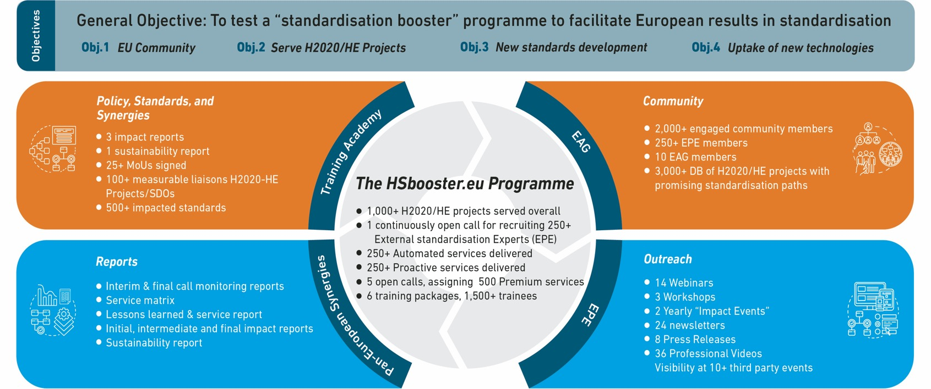
HSbooster.eu in a nutshell
HSbooster.eu reports and policy briefs can contribute to the EU Standardisation ecosystem providing live information on the activities, status and impact of projects in the standardisation field.
Notes:
The standardization booster is built on 4 main objectives
Firstly to create a community of standardisation experts who will deliver consultancy services to the research performers working on standardisation in H2020 and Horizon Europe projects.
Secondly, to Design and deliver these services to ensure they provide practical and effective guidance to projects and carry value for the researchers themselves so they become an essential boost to their standards-related work.
Thirdly, for the booster services to make a difference in the development revision or creation of standards by ensuring projects have the right information and expertise at hand to share research outputs in the standardisation field.
And finally increase uptake of new technologies resulting from standardisation activities. The mapping exercise will assess and map those projects supported that have demonstrated specific uptake of any new technologies resulting from standardisation activities.
The beating heart of the project is the HSbooster programme a result of which will deliver a series of unique reports and policy briefs highlighting in practical terms how and projects are contributing to standardization activities. We hope that these reports can feed into the new standardization ecosystem which is being formed in Europe.

Slide 10
List of Speakers & Agenda
Ray Walshe - StandICT.eu 2023 EUOS Director
Oscar Diez - Head of Sector Quantum Computing at European Commission
Richard Pitwon - Chair IEC TC 86/SC 86B & StandICT.eu 2023 Fellow
Nicolas Spethmann - Co-chairs of Cen-Cenelec FGQT
Nooshin Amirifar - Project Manager and Secretariat member of Cen-Cenelec FGQT
Jonathan J. Attia - President at Feynman Foundation and Chair of IEEE P2995 WG
)

Slide 11
Ray Walshe Director StandICT EUOS Dublin City University Ray.Walshe@DCU.ie
https://www.linkedin.com/in/raywalshe

