Slide 1



StandICT.eu 2023
“Walk & Talk” Webinar on Women In ICT Standards
25^{h} January 2022
Silvana Muscella – Trust-IT CEO & Coordinator of StandICT.eu 2023

Slide 2
Women and ICT Standards – A steadily growing bond
Key-objectives behind the #WomenInICTStandards series:
Strengthen the participation of Women Experts in StandICT.eu 2023 Fellowship Programme (23% of the funded experts are female among all experts funded at the moment) and women’s active role within SDOs TCs and/or WGs
Raise awareness of the initiative amongst women engaged in ICT standardisation and operating in the most topical tech domains.
Showcase the foundational role of women in ICT, relevance over the past years and showcase best practices.
Demonstrate how the activity of #WomeninICT Standards may fit into the EC ICT Rolling Plan & how they’re making a difference in each domain!

Slide 3
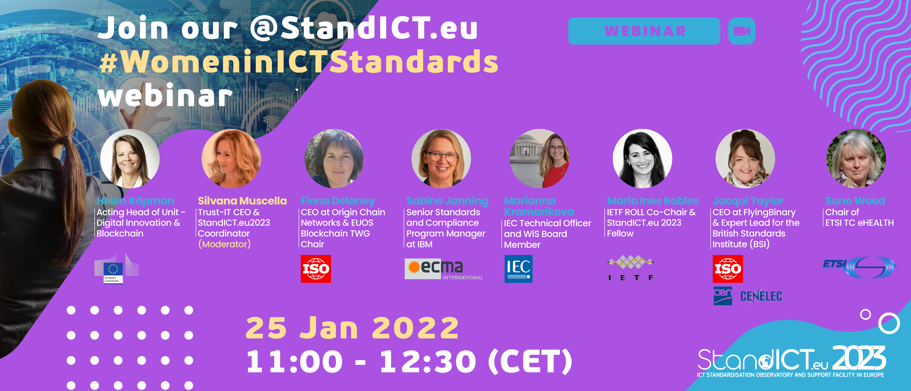
#WomenInICTStandards – 1st Episode
25.01.2022
SPEAKERS 🎙

Slide 4


Webinar Housekeeping
The event will be recorded and will be made available on StandICT.eu 2023 website within the next 24 hours (inclusive of the PPT presentations of each speaker).
Interactive chat is available by default.
We do encourage you though to enter any question in the dedicated Q/A box placed in the lower toolbar. The speakers will be pleased to answer back your questions real-time.
You can follow the chat to be informed and receive link on the main StandICT.eu outputs and publications.

Slide 5
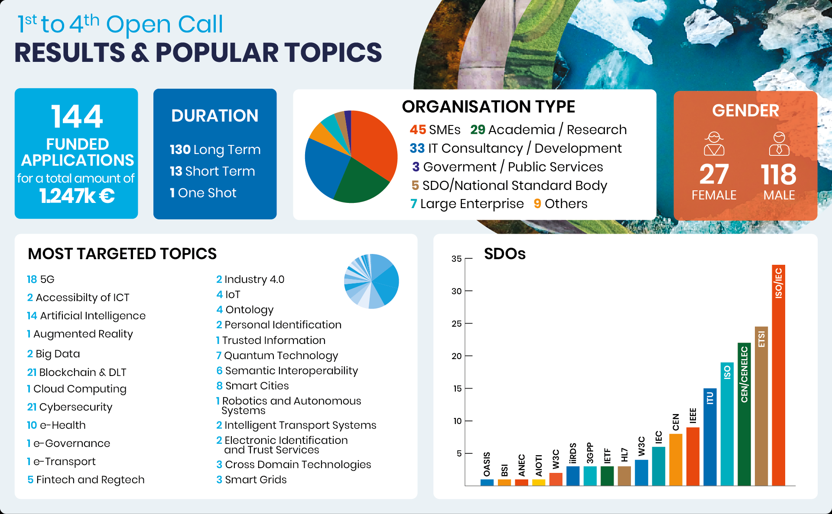
StandICT.eu 2023 – What happened so far?
Snapshot on Open Calls, Major Accomplishments & next steps
Consistent number of proposals coming from applicants coming from SMEs and/or IT field as well as from Academia/Research
Cybersecurity, 5G, AI, and Blockchain proved to be yet the most popular topics.
A wide range of different topics tackled: e-Health; Semantics; Smart Grids; Smart Cities and more.

Slide 6

06th StandICT.eu 2023 Open Call
📣 Working in ICT Standards & need financial support to move your research along?
Deadline to submit applications: 📅 14th February 2021 – 5pm (CET)

Slide 7


#1 and #2 Open Call Impact Report
StandICT.eu 2023 published its first Impact Report on August 2021 and 2nd one in December 2021:
Its primary goals are to:
Provide a thorough Impact assessment on funded applicants in terms of target outcomes for EU priorities, gaps, and challenges;
Share the results attained through the work carried out by the funded expert.
Gather feedback on the efforts that need to be made to improve legislation and policy-regulation in their corresponding areas.
Download via Zenodo
72 Fellows (ICT Specialists) featured to highlight the tangible impact achieved through their activity in key tech-areas (as IoT, Cybersecurity, 5G, Blockchain,
e-Health..) and the addressed EU priorities & gaps.
A tailored Impact Report will be issued for each corresponding Open Call !

Slide 8


A functional gateway to quickly access both main areas of EUOS, Repository of Standards & Discussion Groups even leveraging the interactive map and following the required topic
JOIN US! https://www.standict.eu/euos
Incremental approach to the EUOS on a streamlined, automated system on adding standards to the observatory once the Landscape reports are issued & published.

Slide 9





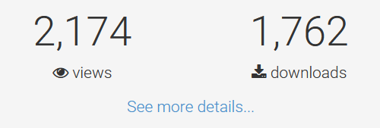
TWG Landscape Report Series
“Landscape of Artificial Intelligence Standards”, published in June 2021,
is the fruit of the dedicated Technical Working Group (TWG AI).
Landscape of Smart Cities Standards also availale!
Stay tuned to our channels!
The Report provides an encompassing compilation of standardisation efforts underway in the framework of European SDOs, such as CEN and ETSI, Government, Public Bodies and Agencies, Global SDOs, and initiatives.
New reports are expected to be published soon:
TWG Trusted Information Report –> February 2022
Digital Twins -> March 2022
Upcoming reports –> Cybersecurity, BLOCKCHAIN, Edge/Cloud & more in 2022!
Zenodo Views & Downloads
(AI report)

Slide 10
Silvana Muscella
Trust-IT CEO & Coordinator
of StandICT.eu 2023
s.muscella@trust-itservices.com

