Slide 1
Dr. Susanne Guth-Orlowski
SSI-Expert
European Commission Fellow
Chief Innovation Officer, Spherity

Slide 2
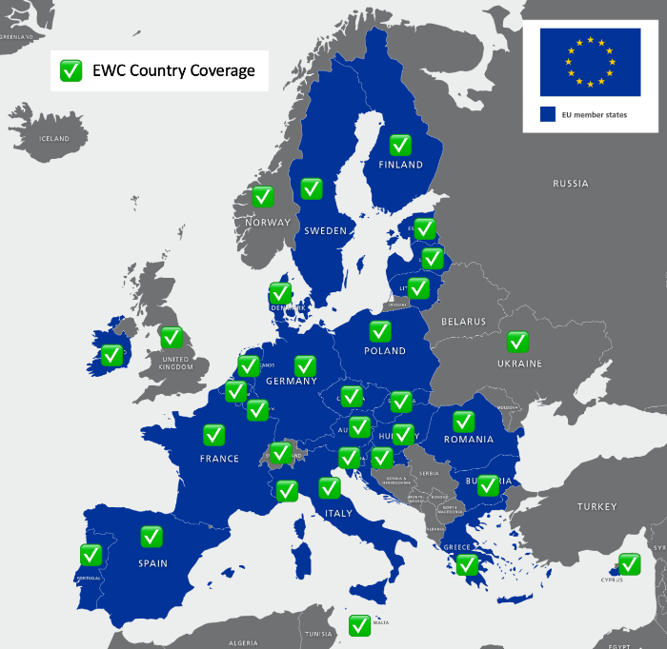
Projects on Identity & Supply Chain
Business Ecosystem | Scope | Key Partners | Spherity's Focus | Support Type
CARO | Authorized Trading Partner (ATP) authentication for compliance in the US Pharma Supply Chain For the Drug Supply Chain Security Act | RFXEL, Novartis, SAP, LEGISYM, HDA | Enterprise Identity | Commercial Production Deployment
EUDI Wallet | - eIDAS 2.0 Revision - EU Digital Identity Wallet - Citizen ID - Enterprise ID | Schweizerische Bundesbahnen AG, Worldline, Amadeus, Sicpa, Intesi Group, DATEV, IDunion, some EU member states | Enterprise Identity | R&D contract, EU funded
Trace4EU | - Digital Product Passport - ArgriFood Track & Trace - EBSI Compliant | 33 Partners (Trace4EU R&D Consortium, Infocert, Intesi Group, some EU members states, 10 Governments, other) | Lead Workpackage for Product + Material Tracing | R&D contract, EU funded
MaDiTraCe | - Raw Material Traceability - EBSI Compliant - Digital Product Passport | 15 Partners (e.g., DMT, BRGM France, Montanuniversität Leoben, University Gent) | DPP / Identity for Critical Raw Material Tracing | R&D contract, EU funded
Energy & Mines Digital Trust (EMDT) | - Enterprise ID - ESG Compliance / GHG reporting State Licenses | British Columbia Government, Pricewaterhousecoopers (pwc), London Metal Exchange, Wallet Providers | Enterprise Identity | Development, SaaS
IDunion | Identity & Trust Enterprise ID Digital Product Passport | Bosch, Bundesdruckerei, Deutsche Bahn, Deutsche Telekom, ING, Siemens, Gematik, Merck, DATEV, Bundesanzeiger Verlag | R&D Focus, Business Development, Product Passport Definitions | R&D contract. German BMWK
Gaia-X Federation Services | Identity & Trust Data Spaces Domain Use Cases (Automotive, Supply Chain, Energy, other) | BMWK, eco Verband, T-Systems, etc. | Building the NOT API | Open Source Development

Slide 3
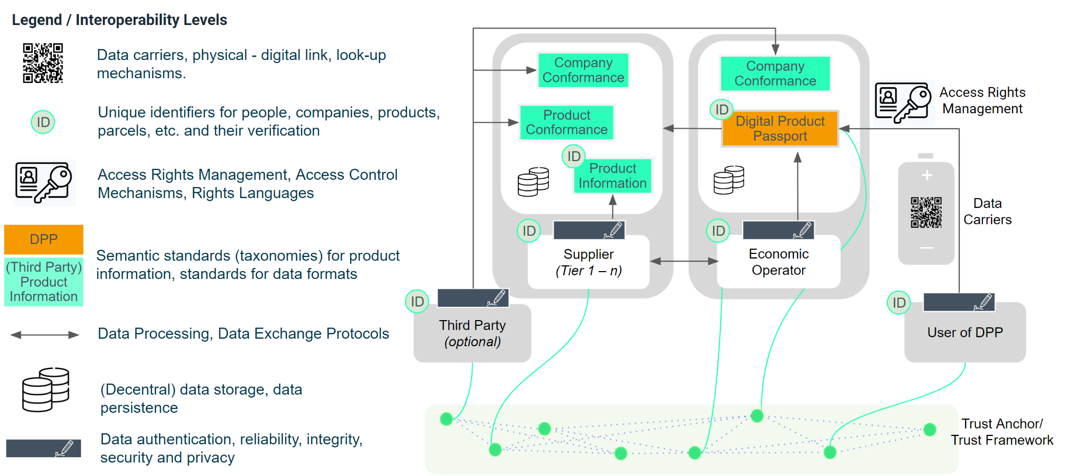
Generic Architecture for Landscape of Digital Product Passport Standards

Slide 4
What you can do and can‘t do with the report
What you can do:
Find a collection of standards to implement a DPP in your industry / product segment.
Understand the areas where technical standards are needed.
What you can’t do:
Use it as best practice on how to implement DPPs compliant to the ESPR regulation.
See how the standards relate to each other.
What is needed, is a guideline how to use the standards, which ones relate to each other and which ones make your DPP solution compliant. → Security of investment!

Slide 5
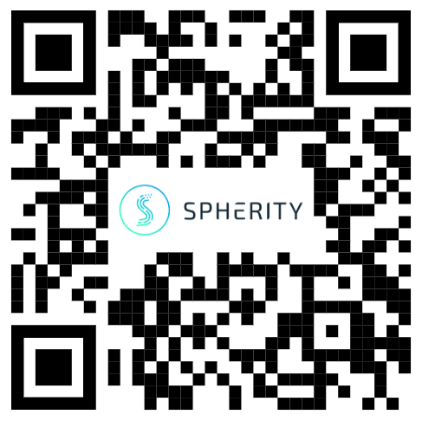
How to use the DPP Standards Landscape implementing a decentral solution
Guth, Ebert, Thiermann, “Implementing Digital Product Passports using decentralized identity standards”, Medium, April 2023
Short summary: It references standards from the Landscape and shows best practice how to:
Create decentralised identifiers for involved parties and products
Issue data for a digital product passport,
Create a data carrier
Find the digital product passport by using a data carrier.
Verify data of the digital product passport.
Benefits of a decentralised approach
https://medium.com/p/f1102c452020/

Slide 6
Benefits of a decentralised DPP implementation
Companies have a high need to insert trusted data into their internal systems. Data in the form of verifiable credentials can meet this need and provide an end-to-end verifiability.
A decentralised approach allows an ad-hoc trusted data exchange data without a bilateral integration, also referred to as ‘decentralised integration’.
A decentralised approach makes central components obsolete, which saves development, deployment, management and other ongoing costs which come with central components.
We see first implementations of decentralised data ecosystems in the Gaia-X, Gaia-X Federation Services, and in Catena-X.

Slide 7
Continued benefits
Product information stays with its owner. The owner of the data has full control over who can access his data.
Because product & company data is not uploaded to central platforms and shared multiple times, the data is always up to date.
Entry barriers are low as reference implementations of the open standards are open source (GXFS).
Decentralised technology is inclusive and permissionless. Everyone with a wallet can technically participate in the ecosystem.
Potentially, the approach helps show compliance to other regulations (such as the Supply Chain Act, the EU Directive on corporate sustainability due diligence, EU Critical Raw Materials Act, the lately announced Green Claims Directive)

Slide 8
Get in touch!

