Slide 1
ESPR, DPP and global, open standards
Francesca Poggiali,
Chief Public Policy Officer Europe,
GS1 Global Office

Slide 2
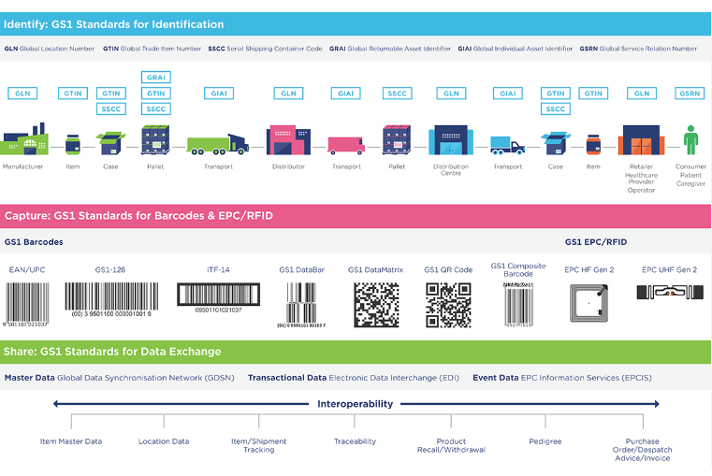
About GS1

Slide 3
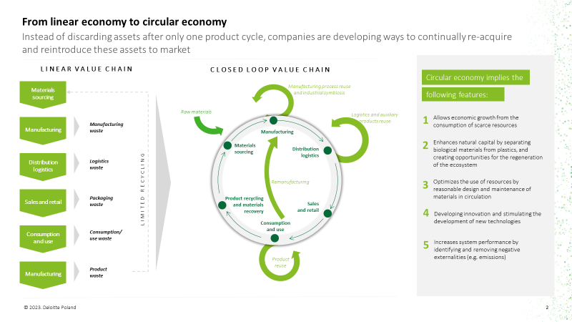

Slide 5
Piloting GS1 standards

Slide 6
Let’s join forces!

Slide 7
Francesca.poggiali@gs1.org

