Slide 1
Digital Product Passport – Example case
Thomas L. Rödding
CEO @ Narravero
www.narravero.com

Slide 2
Benefits demonstrated in a use case
Digital Product Passports (DPPs) enable products to talk about:
their provenance and living biography,
their best use and maintenance,
their re-capabilities,
their authenticity (value/brand protection).
We let your products talk. Narravero.com

Slide 3
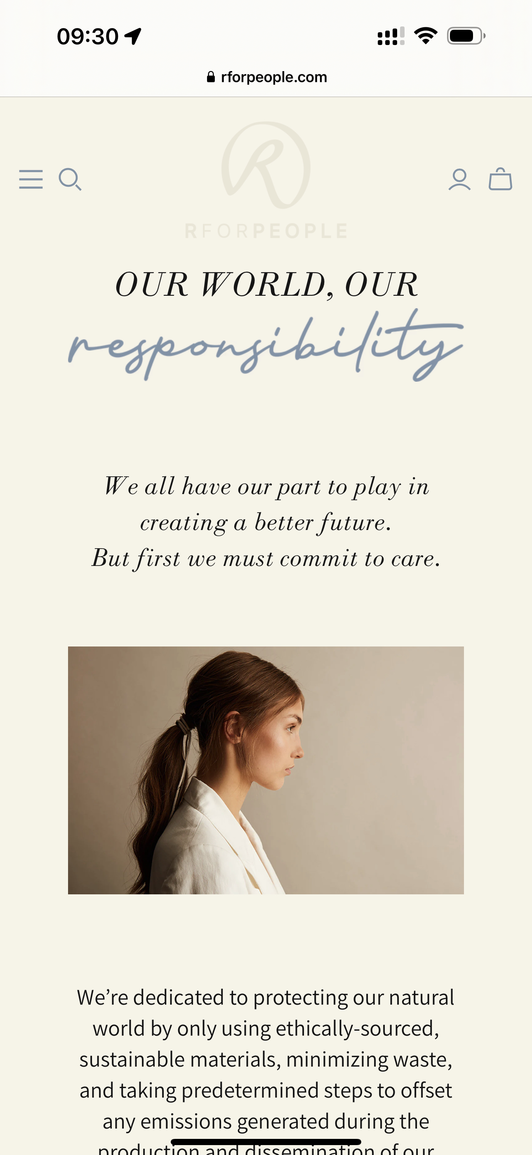
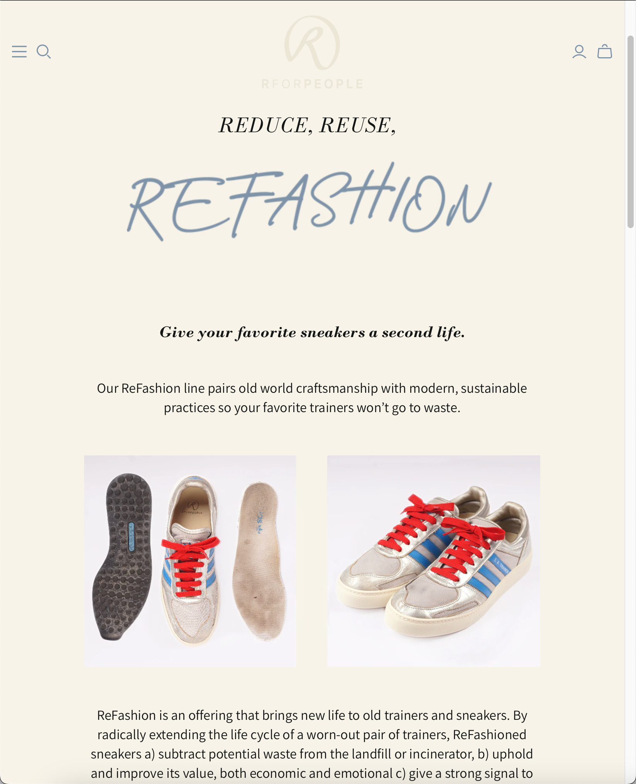
Meeting Stefano Bemer, June 20th 2022
True passion for sustainable products.
And an early adopter of Digital Product Passport.
Giving your favorite sneakers a second life.
Why?

Slide 4
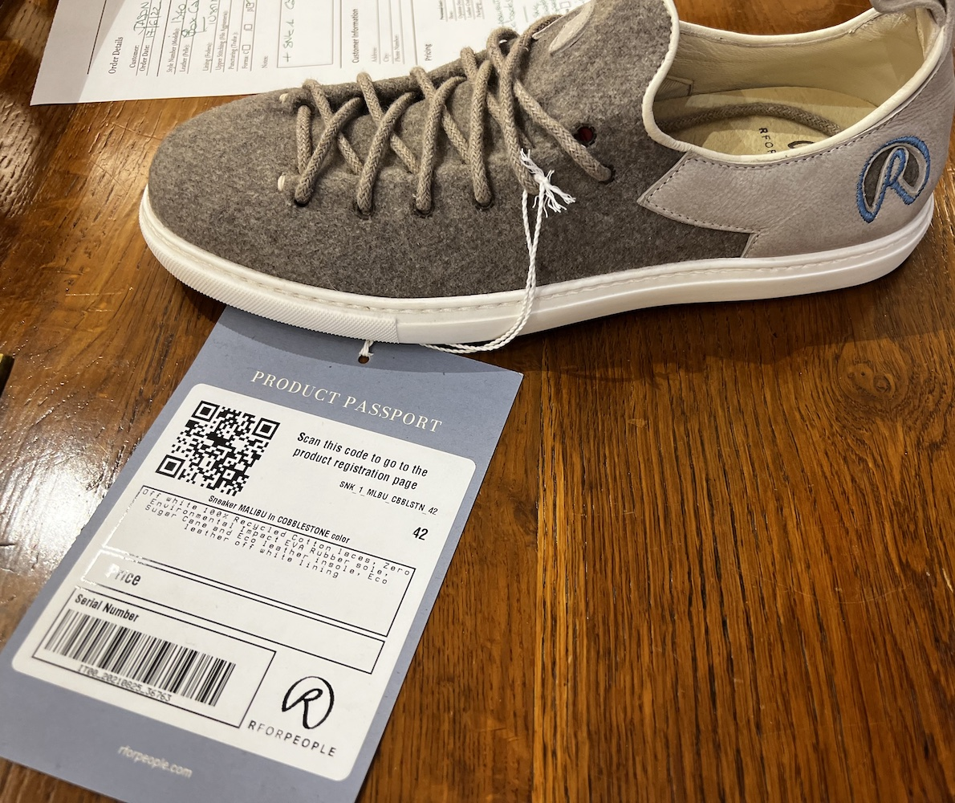
1st Meeting Stefano Bemer, June 20th 2022
Product Passports (DPPs) attached as a paper tag representing the intention:
explain more about product & sustainability (sustainable shoe brand RforPEOPLE)
enable direct dialog btw. consumer and brand
their authenticity (value/brand protection).

Slide 5
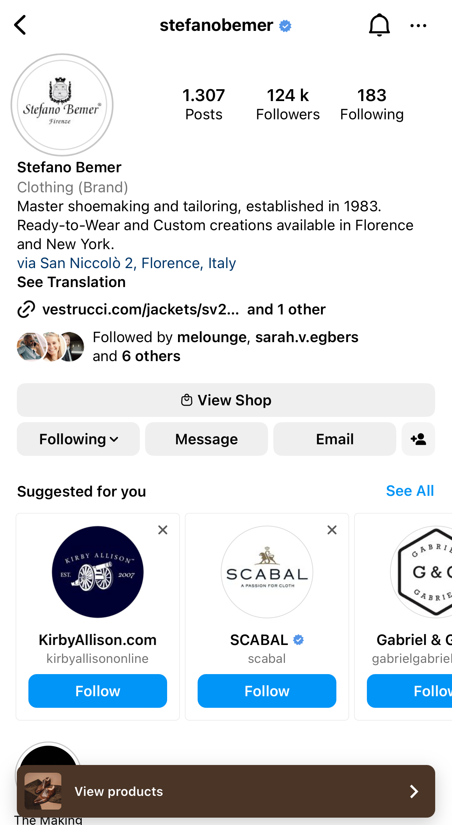
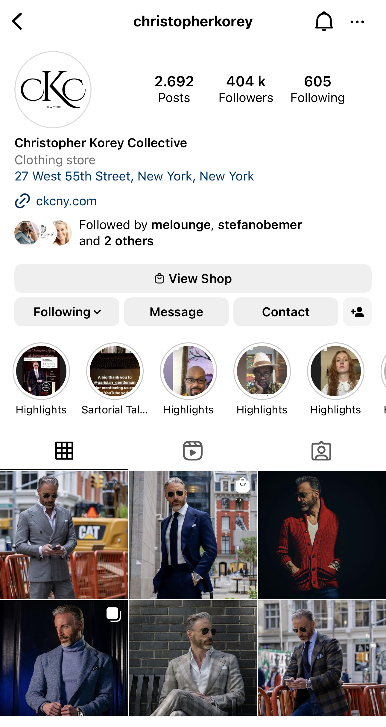
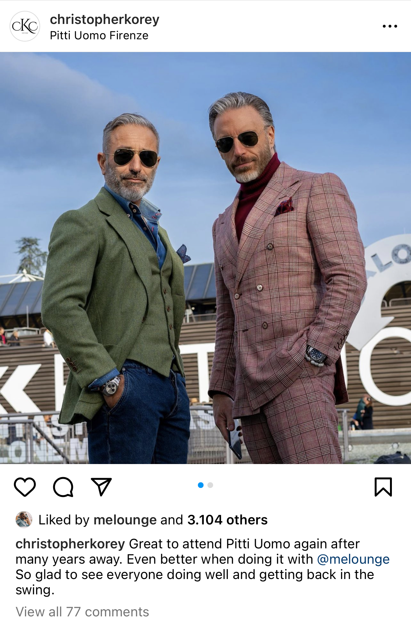
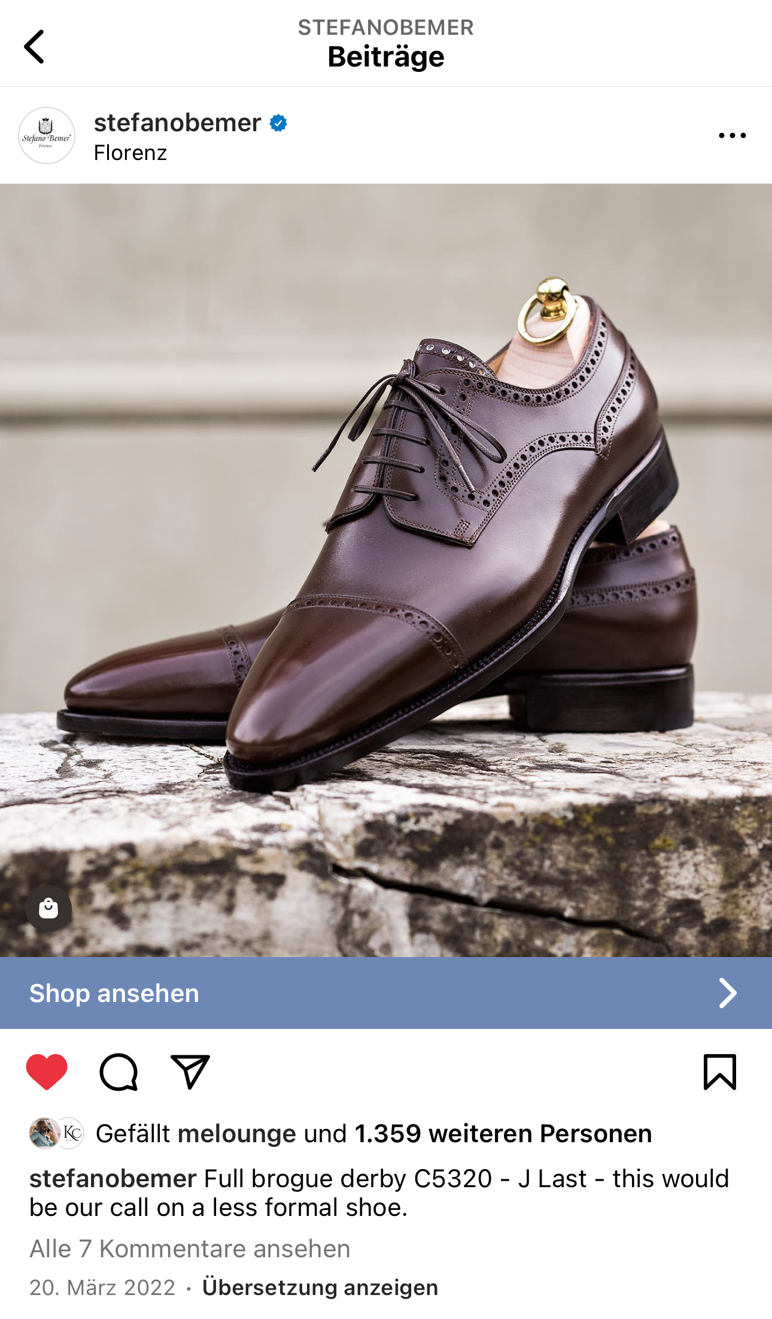
Stefano Bemer, Florence & New York
Tommaso Melani‘s brands
Stefano Bemer (shoes)
Christopher Korey (suits)
We let your products talk. Narravero.com

Slide 6
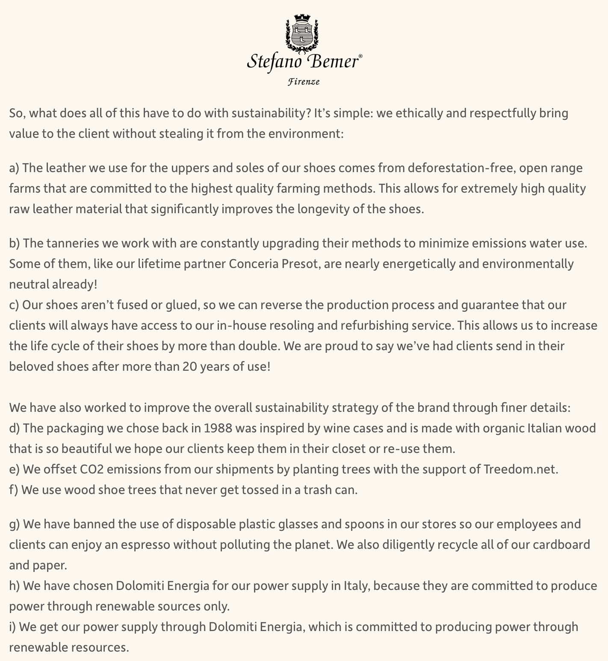
Stefano Bemer, Florence & New York Company’s commitment - sustainability
Eco-design:
„Keep walking“ for 20 years!
Sustainable sourcing (leather), reduced water usage, no glue - and more
Timeless design
Construction designed for repair-possibilities and longevity (re-soling, refurbishing)
Circularity: return at EOL to Stefano Bemer
Digital Product Passport – why?
Analog product with a digital interface
Know Your Customer - retail
Branding & Marketing – pre- & after-sales
Doing the bare minimum (compliance) AND going the extra mile (customer-centricity)
Making a difference needs to be snown
Enabling consumers to have a direct comms channel
Enabling the business to „own“ a direct comms channel
We let your products talk. Narravero.com

Slide 7
33 seconds of a real-world example
SIMPLICITY WINS.
If consumers benefit from using DPPs,
businesses will benefit by providing DPPs.
Extending the „I have to tell“ to „I want to tell“ becomes the key.
Easy to use. Easy to manage. Open standards and inter-operability.
We let your products talk. Narravero.com

Slide 8
Upcoming tasks to implement DPPs
Marketing Officer:
Authoring Media, Text, Data
Syndication of data & content
Analytics & insights
Sustainability Officer
Logging relevant data along the value chain
(Structural) Supply Chain Due Dilligence
(Transactional) Supply Chain Transparency
„DPP Officer“?
Managing Versions
Dependencies
Updates
Components
Corrections & Changes
Publishing Releases to the registry
Fraud detection
Backbone
Globlal, scalable, Syncing Cloud
Offline & Online Sync
Content Syndication
Connectors: ERP, Content, ECommerce

Slide 9
Behind the scenes
DPP Use and Management
Sustainability Officer
Supply Chain Traceability and Product Transparency
A stage to provide visibility for the implemented sustainability
Marketing Officer
A stage to provide visibility on the brand, sustainability and more
Extending compliance to customer-centric experience
Both
Data Management (collect, analyse and visualize)
Versioning, publishing, information lifecycle insights
Next Stage: sustainable and circular product design incl. DPPs leads to new thinking: ‚Products-as-a-Service‘

Slide 10
Thank you & Get in touch

