Slide 1
Walk & Talk Webinar Digital Product Passport Making informed choices and protecting brands
Silvana Muscella Trust-IT CEO & Technical Coordinator of StandICT.eu 2026
28th April 2023

Slide 2
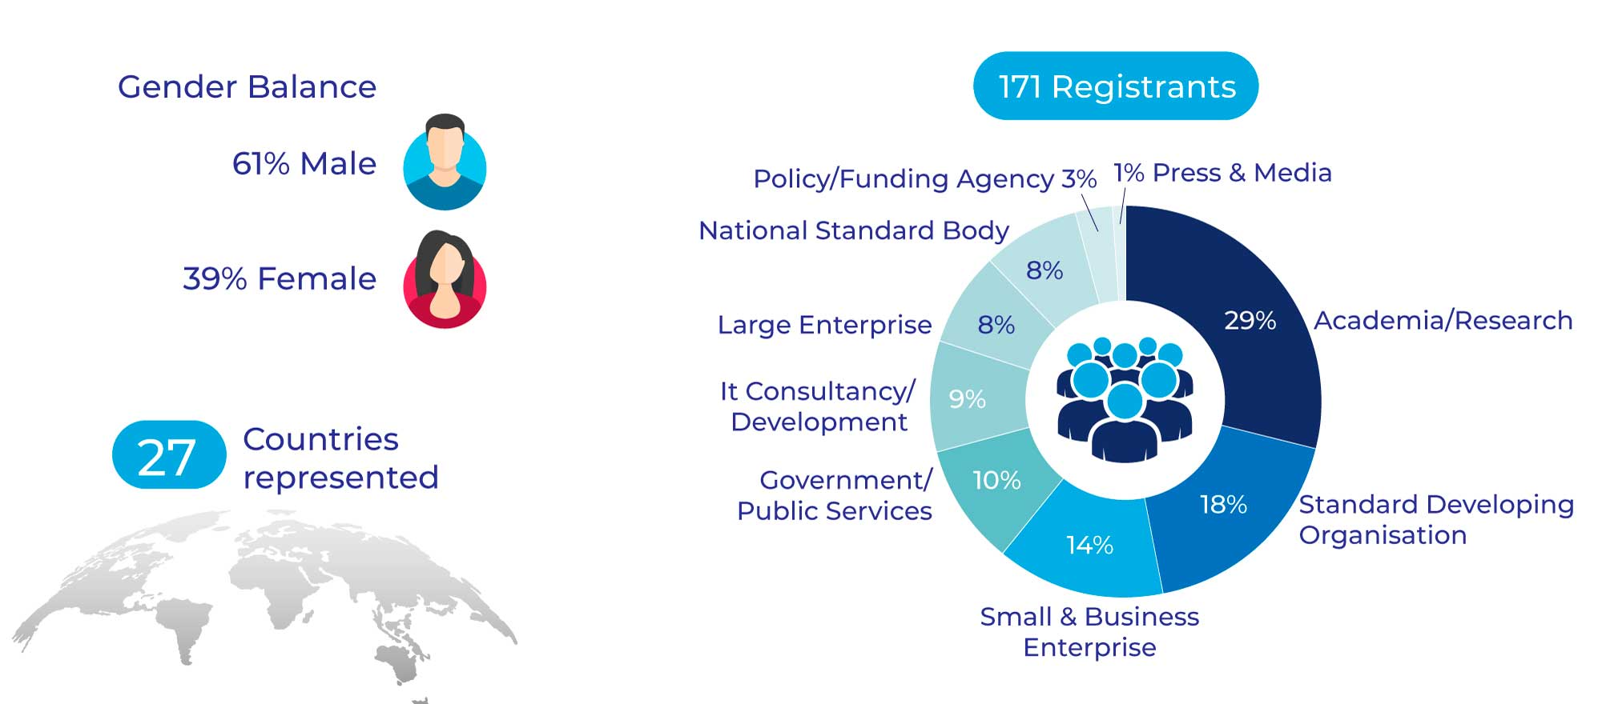
WHO has joined the W&T Webinar on the Digital Product Passport

Slide 3
W&T Webinar Housekeeping
The event will be recorded and will be made available on the StandICT.eu website within the next 24 hours (including the presentations of each speaker)
We do encourage you though to enter any question in the dedicated Q/A box placed in the lower toolbar. The speakers will be pleased to answer back your questions real-time
You can follow the chat to be informed and receive link on the main StandICT.eu outputs and publications.

Slide 4
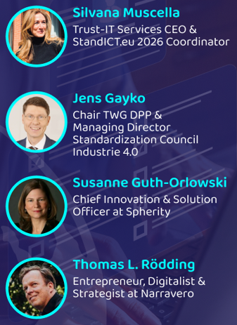
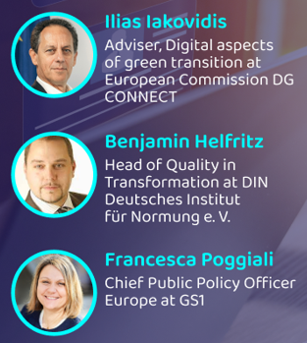
W&T Webinar - Digital Product Passport
SPEAKERS
Q&A

Slide 5
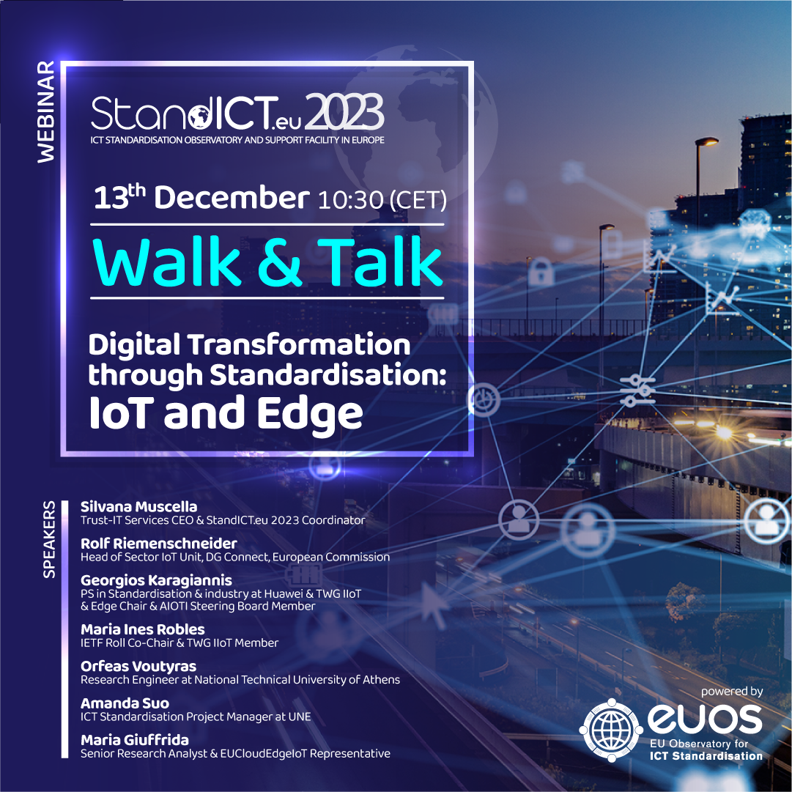
Walk & Talk StandICT.eu Webinar Series
The Walk & Talk Webinar is a series of virtual events that tackles each of the corresponding EUOS TWGs to put their outcomes into the spotlight and that features the related members in order to provide an accurate overview and analysis of the corresponding ICT domains. previous episodes on IoT & Edge, Quantum Transformation, DLT, Digital Twins, etc.

Slide 6
Landscape of Digital Product Passport Standards
186 international and European standards from recognised standardisation bodies
further 78 standards from other standards developing organisations.
603
downloads
Check it out on Standict.eu
Download the report via Zenodo

Slide 7
Landscape Standards Reports The fruit of StandICT.eu Technical Working Groups in key ICT areas
NEW An OpenAccess database of DPP-related specifications and documents from the global community!
NEW
“Landscape of AI Standards”, “Landscape of Smart Cities” , “Landscape of Trusted Information” and “Landscape of Digital Twins” & Landscape of IoT Standards, Edge Computing and DPP released! (12 TWGs ongoing including +110 experts)
Next release in May 2023 Report from TWG focusing on Ontologies

Slide 8
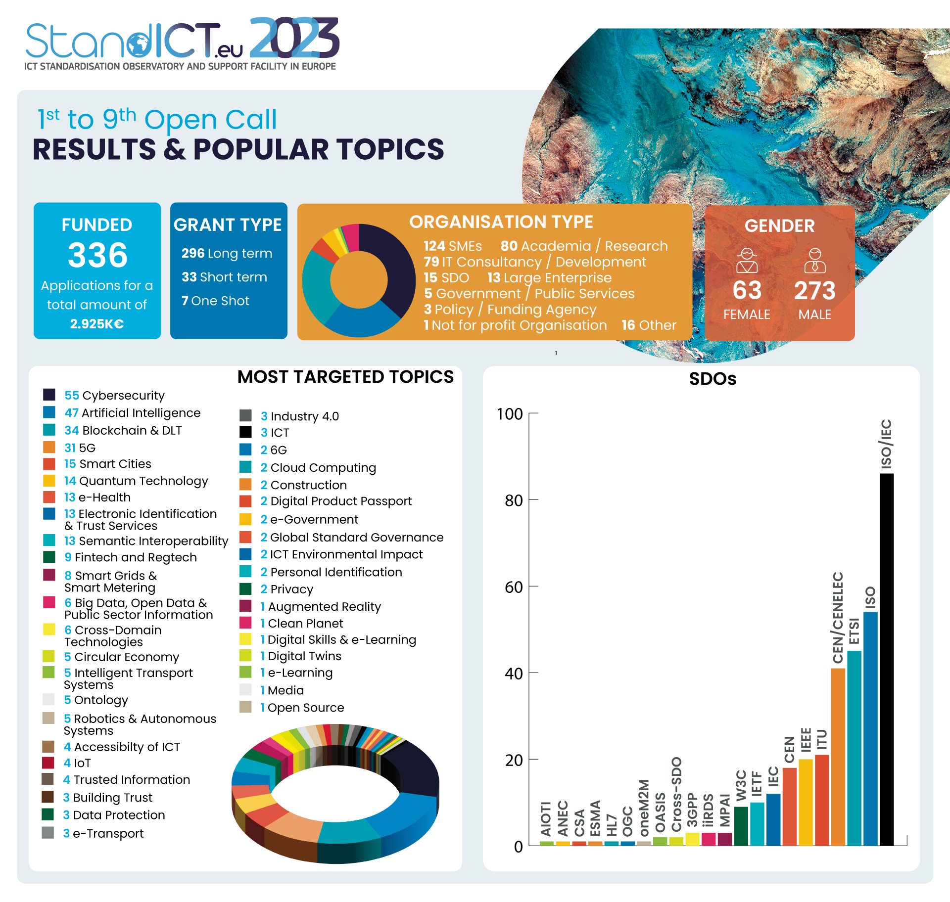
Open Calls from 1 to 9 Facts, Figures & Major Accomplishments
Consistent number of proposals coming from applicants coming from SMEs and/or IT consultancies as well as from Academia/Research
A wide range of different topics tackled: e-Health, Semantics, Smart Grids, Smart Cities and more.
Cybersecurity, AI, Blockchain & DLT and 5G proved to be yet the most popular topics.

Slide 9
StandICT.eu 2026 – External Pool of Evaluators
Our experts will be key to ensuring an impartial, transparent and consistent review process of applications to the Open Calls
APPLY NOW
the Call for Evaluators open until
31st May 2023
– 11:59 pm (CEST)
APPLY NOW

Slide 10
StandICT.eu 2026 - 1st Open Call in May
Working in ICT Standards & need financial support to move your research along?
SAVE THE DATE
9th May 2023
– 11:59 pm (CEST)
SAVE THE DATE
Applications tackling the Metaverse & DPP domains are very welcome

Slide 11
A functional gateway to quickly access both main areas of EUOS, Repository of Standards & Discussion Groups even leveraging the interactive map and following the required topic.
JOIN US!
https://www.standict.eu/euos
Incremental approach to the EUOS on a streamlined, automated system on adding standards to the observatory once the Landscape reports are issued & published.
11

