Slide 1
Education in Standardization from an academic point of view
Ivana Mijatovic, PhD, full professor University of Belgrade, Faculty of Organizational Sciences, Serbia E-mail: ivanamt@fon.bg.ac.rs

Slide 2
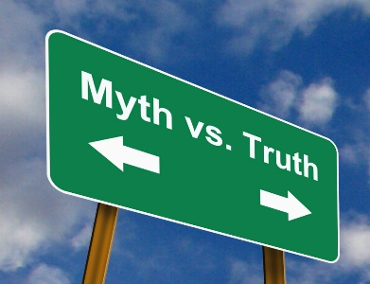
Common perspective
“Standards control access to virtually every market in global commerce, and directly affect more than eighty percent of world trade...”
Purcell, D., Kushnier, G. (2016)
University education does not develop the necessary competencies related to standardisation, yet.
However, standardisation is neither a science, nor even generally accepted academic discipline world wide.
MYTH 2: “Masters of standardisation are not needed” it is better to enlarge the group of people that are aware of the usefulness of standardisation and acquaint possible future decision-makers with the subject. How?
MYTH 1: Once standardisation is recognized in HE curricula, general awareness and appreciation of S&S’ benefits will automatically result (Simons, 1999). Will it?

Slide 3
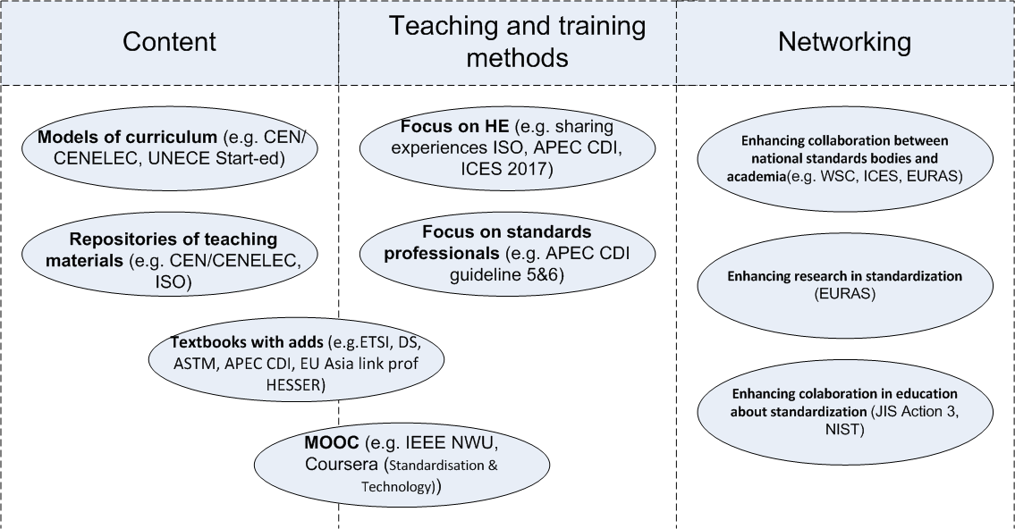
What we already know...
Once upon a time there were many initiatives related to education about standardization...
Valuable imputs, but still lot of works in a curriculum development - Always over and over again
Two main problems: content centered and teacher centered teaching methods
The major changes: Generation Z
Deep misunderstanding

Slide 4
Building awareness? Time consuming and difficult task
Competence: ''the proven ability to use knowledge, skills, and personal, social and/or methodological abilities, in work or study situations, and in professional and personal development'‘ (EU, 2017)
Expertise: '' a dynamic state, domain-specific, and the key components of expertise are knowledge, experience, and problem-solving (Swanson, 2007 )

Slide 5
References
EU,(2017).COUNCIL RECOMMENDATION of 22 May 2017 on the European Qualifications Framework for lifelong learning and repealing the recommendation of the European Parliament and of the Council of 23 April 2008 on the establishment of the European Qualifications Framework for lifelong learning , Official Journal of the European Union, 15.06.2017., C189/20.
Mijatovic, I. (2020). Teaching standardization to Generation Z – Learning Outcomes Define Teaching Methods, in Idowu, S.O. de Vries, H.J. Mijatovic, I. Donggeun C. (eds.)(2019) Sustainable Development – Knowledge and Education about standardization, Springer Nature Switzerland, ISBN 978-3-030-28714-6, DOI:10.1007/978-3-030-28715-3, pp 191- 208, DOI:10.1007/978-3-030-28715-3_12
Purcell, D., Kushnier, G. (2016, March/April). Globalization and Standardization. The Journal of SES – The Society for Standards Professionals. Retrieved from http://www.standardsuniversity.org/e-magazine/august-2016-volume-6/globalization-and-standardization/
Simons C.A.J., Education in Standardization – Getting structured common sense into our society – The personal opinion of standards educator, ISO Bulletin, June 1999.
Swanson, R. A. (2007). Analysis for Improving Performance - Tools for Diagnosing Organizations and Documenting Workplace Expertise (Second Edi). Berrett-Koehler Publishers, Inc.

