Slide 1



StandICT.eu 2023
“Walk & Talk” Webinar on Digital Twins: Evolving Global Standards
16th December 2021
Silvana Muscella – Trust-IT CEO & Coordinator of StandICT.eu 2023

Slide 2





“Walk & Talk” StandICT.eu 2023 Webinar Series
The “Walk & Talk” Webinar is a series of virtual events that tackles each of the corresponding EUOS TWGs to put their outcomes into the spotlight and that features the related members in order to provide an accurate overview and analysis of the corresponding ICT domains
(previous episodes on Artificial Intelligence, Trusted Information, Smart Cities, Education and Standards..)

Slide 3
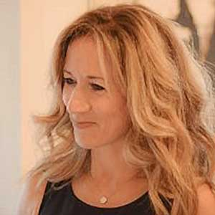
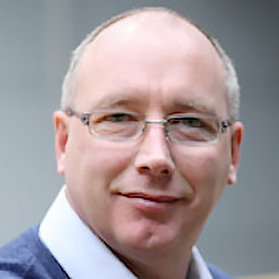
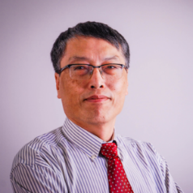
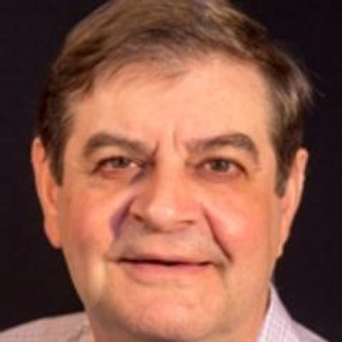
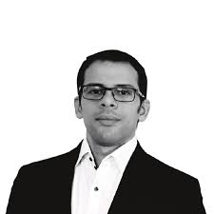
Digital Twins – Evolving Global standards
SPEAKERS 🎙
Silvana MUSCELLA
CEO, Founder Trust-IT Services & StandICT.eu 2023 Project Coordinator
Ray WALSHE
EAG Chair & EUOS Director of StandICT.eu2023 & Standards Leader at Dublin City University
Focus on the EUOS Observatory on ICT Standardisation
Antonio KUNG
CEO at Trialog & EUOS Digital Twin Chair
Impact of digital twins in the Standardisation landcape
Claude BAUDOIN
Principal Consultant for Cébé ITKM & member of the EUOS Digital Twin TWG
Background of the Digital twin Consortium, current activities and Use Cases and contributions to the EUOS Digital Twin TWG
Karim TOBICH
Head of Cybersecurity and Compliance Consultancy & member of the EUOS Digital Twin TWG
Presenting an overview of the activities of the ISO/IEC/JTC1/SC41 on IoT and Digital Twins

Slide 4
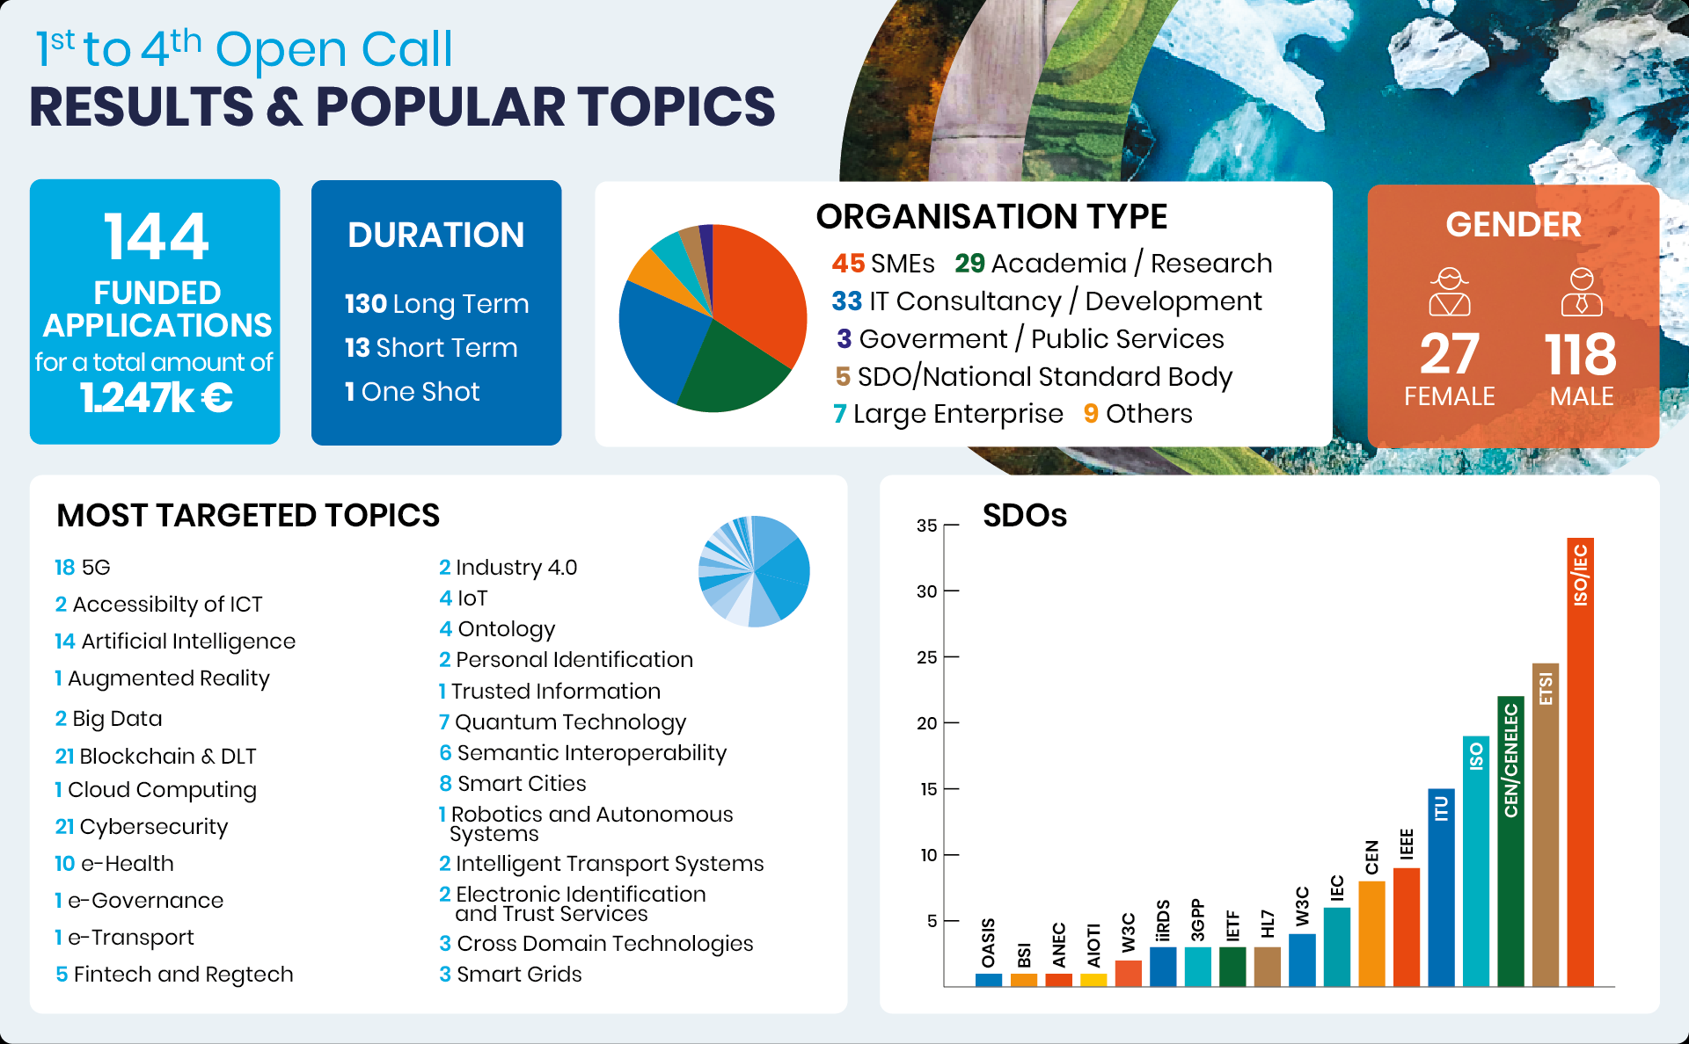
1° to 4° Open Calls – Facts, Figures & Major Accomplishments
Consistent number of proposals coming from applicants coming from SMEs and/or IT field as well as from Academia/Research
Cybersecurity, 5G, AI, and Blockchain proved to be yet the most popular topics.
A wide range of different topics tackled: e-Health; Semantics; Smart Grids; Smart Cities and more.

Slide 5
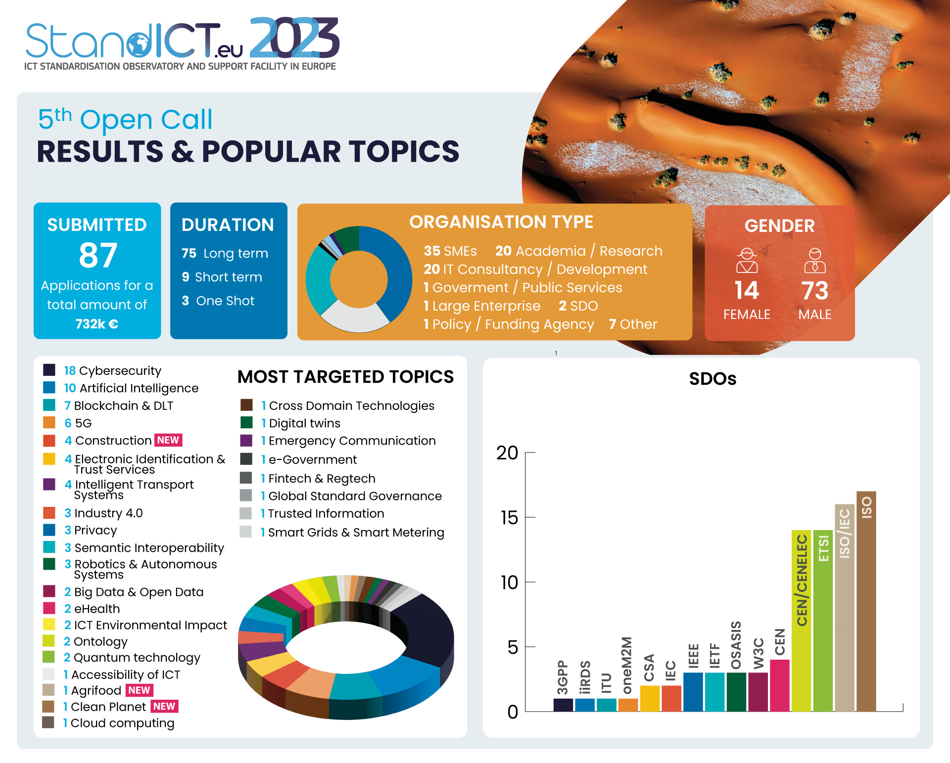
5° Open Call Applications Received - Statistics
These Open calls are an opportunity to
Pursue EU interests in industry Increase EU competitiveness, Support consumers, environmental & workers interest.

Slide 6

06th StandICT.eu 2023 Open Call
📣 Working in ICT Standards & need financial support to move your research along?
Deadline to submit applications: 📅 07th February 2021 – 5pm (CET)

Slide 7


#1 and #2 Open Call Impact Report
StandICT.eu 2023 published its first Impact Report on August 2021 and 2nd one last week:
Its primary goals are to:
Provide a thorough Impact assessment on funded applicants in terms of target outcomes for EU priorities, gaps, and challenges;
Share the results attained through the work carried out by the funded expert.
Gather feedback on the efforts that need to be made to improve legislation and policy-regulation in their corresponding areas.
Download via Zenodo
72 Fellows (ICT Specialists) featured to highlight the tangible impact achieved through their activity in key tech-areas (as IoT, Cybersecurity, 5G, Blockchain,
e-Health..) and the addressed EU priorities & gaps.
A tailored Impact Report will be issued for each corresponding Open Call !

Slide 8


A functional gateway to quickly access both main areas of EUOS, Repository of Standards & Discussion Groups even leveraging the interactive map and following the required topic
JOIN US! https://www.standict.eu/euos
Incremental approach to the EUOS on a streamlined, automated system on adding standards to the observatory once the Landscape reports are issued & published.

Slide 9





TWG Landscape Report Series
“Landscape of Artificial Intelligence Standards”, published in June 2021,
is the fruit of the dedicated Technical Working Group (TWG AI).
The Report provides an encompassing compilation of standardisation efforts underway in the framework of European SDOs, such as CEN and ETSI, Government, Public Bodies and Agencies, Global SDOs, and initiatives.
Landscape of Smart Cities Standards OUT TODAY!
Stay tuned to our channels!
2 new reports are expected to be published soon:
TWG Smart Cities Report –> December 2021
TWG Trusted Information Report –> Early 2022
Upcoming reports –> DIGITAL TWINS, ONTOLOGIES, BLOCKCHAIN

Slide 10
Silvana Muscella
Trust-IT CEO & Coordinator
of StandICT.eu 2023
s.muscella@trust-itservices.com

