Slide 1
ICT 13.10.22
Focus Group on Quantum Technologies (FGQT): activities and perspectives
Dr. Nicolas Spethmann (PTB, vice-chair CEN-CENELEC FGQT)

Slide 2

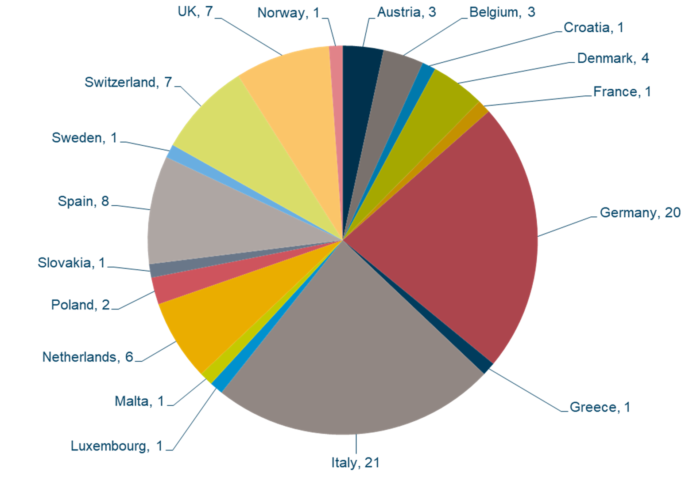
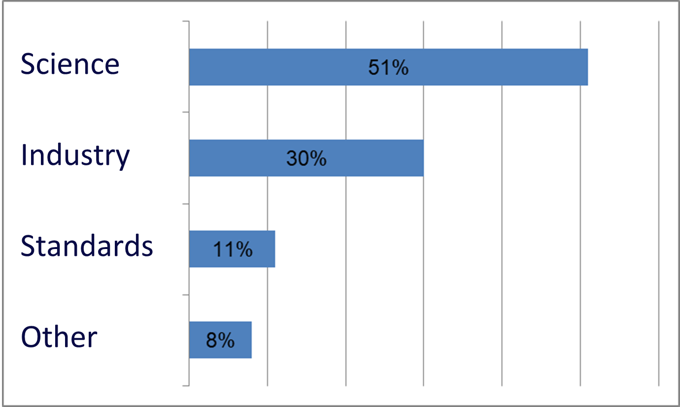
Key Figures FGQT
Founded mid 2020, 150+ delegates, 18+ meetings, 150+ contributions
Developing roadmap, 1st release probably in a few months
  What to standardise (gaps), when, how and by whom
  Coordinate with ISO/IEC, ETSI, ITU-T, QUIC, EuroQCI, Qflag, Qu-Test, other ...
  Spin-off standardisation activities: TC(s) for guidelines, reports, specifications;
  Creation of CEN-CLC JTC 22 ‘Quantum Technologies’

Slide 3
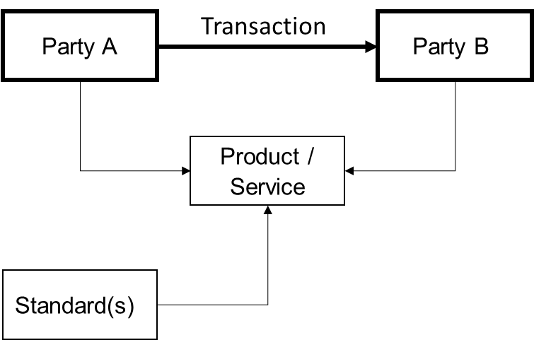
Forum to bring together complementary perspectives
  FGQT as forum for academia, industry and standardization experts: establish a common language in order to be able to work together well, efficiently and quickly in the future

Slide 4
Challenges and Chances
  FGQT includes all QT-fields
This is a challenge:
  Domain experts from diverse, complementary fields
  There is a danger of addressing only a small portion of delegates at one time
  How to address a field as wide and diverse as “quantum technologies”?
And also a chance:
  Many QT components common across fields
  Horizontal layers connect fields
  FQGT can support development of coherent standardization and prevent double-development/work and prevent later adaptions
  Framework for standardization

Slide 5
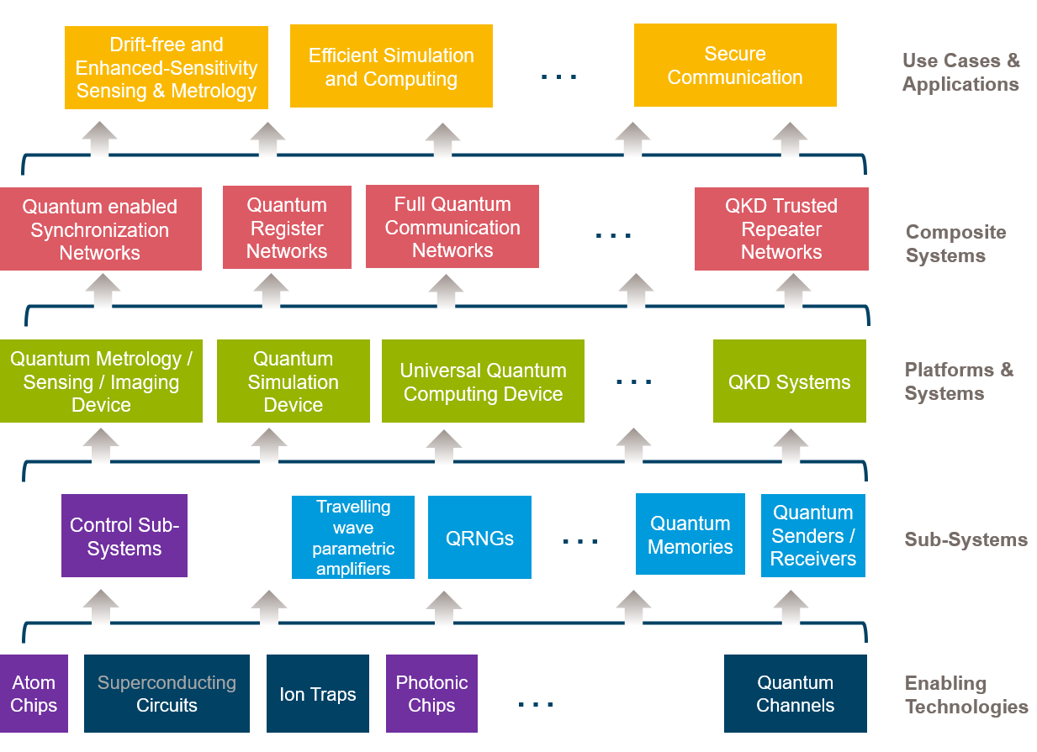
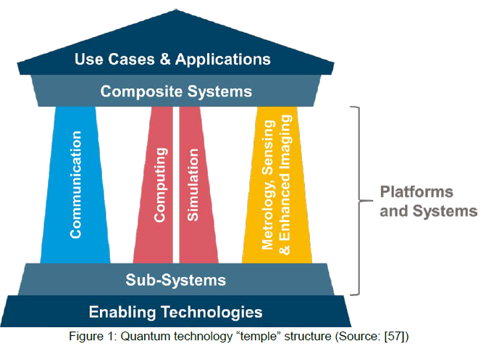
Framework and Identification of Standardization Needs
Horizontal layer and cross cutting of QT components, sub-systems, platforms

Slide 6
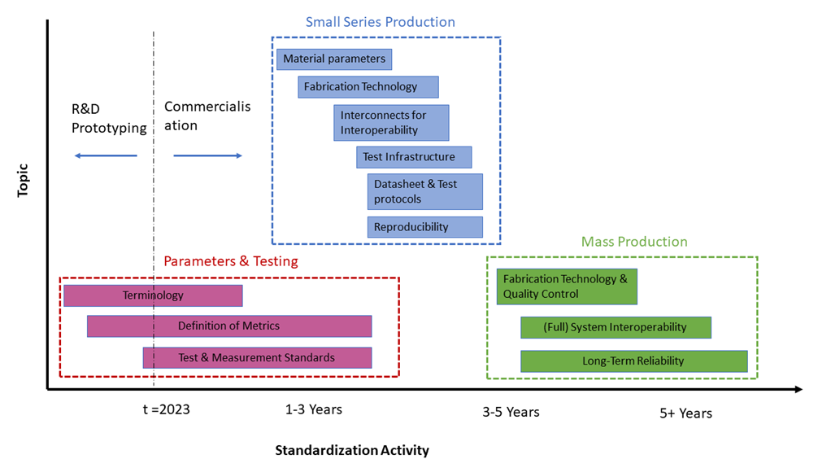
Timeline for Standardization of Enabling Technologies

Slide 7
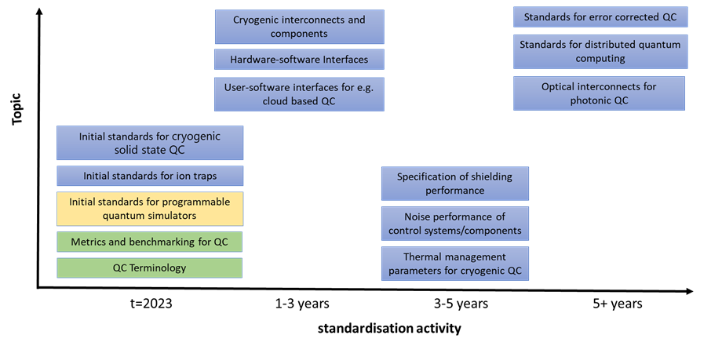
Timeline for Standardization of Quantum Computing

Slide 8
Conclusion & Perspective
  Roadmap: Standards How and When and by Whom?
  European voice in international/worldwide organizations
  Pave the way for technical commitees and specific standardization work: Creation of CEN-CLC JTC 22 ‘Quantum Technologies’
  First important standardization activity: Terminology, metrics, parameters to characterized the quality of components
  Provide overview and guidance: coherent framework for QT standardization
  Help to connect and “streamline” current standardization efforts
„Towards European Standards
for Quantum Technologies“
https://arxiv.org/abs/2203.01622

