Slide 1
ISO/IEC/JTC1/SC41/AG27
Digital Twin workshop summary
Dr. Karim Tobich

Slide 2
Background
AG27 did run 4 workshops on:
  2021-09-16,
  2021-09-21,
  2021-09-23,
  2021-09-28
The objective of the workshop was to gather standard experts having an interest on digital twin related standards, in order to reach a common understanding on
  Use cases,
  Concepts,
  Architecture, and
  Integration
It was an active workshop where participants were invited to contribute and drop any idea into different interactive murals’ sessions

Slide 3
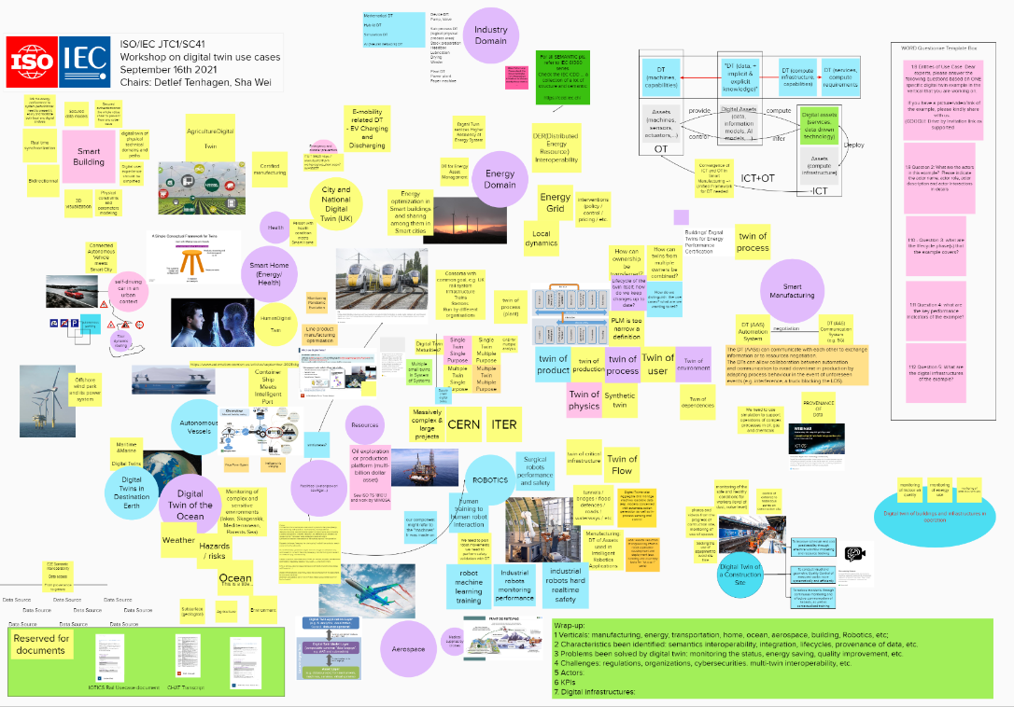
Murals
digital twin use cases
digital twin concepts
digital twin reference architectures
digital twin integration

Slide 4
Use cases – Take away
Experts pointed out the potential role of digital twins can play in any process
It can help make better and faster decision instead of having it on a specific vertical
Such processes could be connected e.g., for the purpose of life-cycle processes as it can be for the purpose of the digital twins that represent them
Experts pointed the need for 'process-based information requirements' and to way of viewing digital twins from information flow perspective through processes and across systems
This also pointed out to the concept of connected digital twins within system and system of system covered in WS4

Slide 5
Concepts – Take away
A definition to a digital twin was given to expert and they were asked to brainstorm about it
Expert highlighted that “entity” can be seen as an asset, process or system
Expert highlighted that appropriate rate of synchronization need to be linked to purpose: with the appropriate rate being determined by the 'purpose'
The notion of a semiotic triangle was introduced with its 3 components: Concept, Symbol, and Object. The relation between object and symbol was discussed (the symbol space contains the textual standards or other explanations written in natural language or in a formal notation by which the ontology of the problem statement is given). Within this notion, the DTw would reside in the concept space because of its powerful mathematical/semantics simulation capabilities
It was raised that an Object could be seen as a Thing and as an Asset. Experts raised the need to give special care to the idea that for one physical asset may have multiple concepts and multiple symbols

Slide 6
Reference Architectures – Take away
The workshop did look at the scope of a Reference Architectures for DTws, with a distinction between two Entity of Interest
  the twin itself (level 0) and
  the twinned system (level1)
At level 0: characteristics can be defined such as
  purpose, encoding, interactions, analytical capabilities, or self-description
At level 1: methods to define the twinned system should be agreed based on
  capabilities prioritization logic, maturity matrix, platform pattern, integration examples, repository of various patterns, reference processes.
It was suggested to consider a viable system model (VSM) of the twin
It was pointed out that there might not be a one-to-one mapping between a digital twin and cyber physical systems –(CPS)
The workshop did look at the purpose of DTw to define its architecture. It was suggested the use of capability map (a maturity matrix) as a tool for achieving its purpose

Slide 7
Integration - Take away
Experts identified the need for cross-functional expertise and coordinated deliverables
Some key points were raised:
  Integration issues, Life-cycle, Composition, Boundaries between IoT, DTw, CPS, MAS,
  “smart” things and “digital” things, Semiotic triangle, Multidisciplinary terminology, IT development with DTw,
  One or many DTw for the same EoI, Workshop on systems architecting
Experts raised the need for :
  Global and detailed view, Need for ontology, Supporting existing systems
  Hardware for deployment of system software (e.g. BOS - building operating system) in the case of an IoT ( edge/cloud) environment
  Multiple driver management, Data characterization
  Scalability of model
  End-to-end security
  End-to-end customer path
Notes:
Multi Agent System (MAS),

Slide 8
More to come
The workshops were a brainstorm sessions to gather ideas and use them as an input to make the future standards
The one currently under development are:
  ISO/IEC WD 30173 Digital Twin - Concepts and terminology
  ISO/IEC WD 30172 Digital Twin - Use cases
  PWI JTC1-SC41-5 Digital Twin - Reference Architecture
  PWI JTC1-SC41-6 Guidance for IoT and Digital Twin use cases
and more will come if required by Technical experts, Consumers, regulators,…

