Slide 1
IS 23257:2022 Reference architecture
The basis for understanding, implementing, and communicating

Slide 2

Background
The state of development of Blockchain and DLT involves a multitude of proprietary and open-source projects, in many cases tackling different problems.
This has resulted in a confusing array of varying descriptions for DLT concepts and for DLT systems built using those concepts.
The confusion is slowing adoption of the technologies and making it difficult for individuals and organizations to make comparisons between different projects and solutions and to implement their own DLT systems
☞
There is a clear market need for a globally-agreed reference architecture for Blockchain and DLT which will form the basis for understanding and implementing DLT systems and which will also enable users and developers of the technologies to communicate effectively.

Slide 3
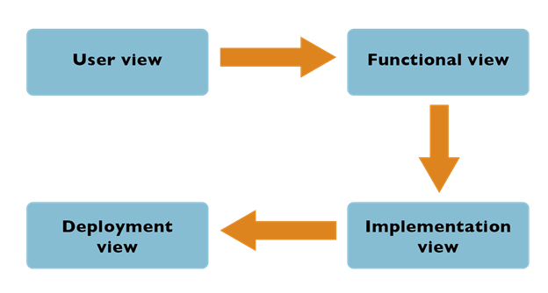
Architectural views
System view
https://cloudgal42.com/quickguide-iso-iec-17789-cloud-computing-reference-architecture-ccra/

Slide 4
System view
DLT Administrators /
Operators
Users
Admin Apps
User Apps
Admin System
User System
Admin API
User API
Node B
DLT Oracles
Access Management
Consensus Mechanism
External I/F
Non-DLT Apps
Membership Services
Event Distribution
Off-Ledger Data
Smart Contract
Secure Internode Comms
Public DLT Network
Node C
Secure Runtime
Crypto Services
Non-DLT Systems
Transaction System
State Management
Intersystem I/F
Other DLT systems
Node D
Ledger
<data struc
ture>
Data Storage
DLT Node A - User Node

