Slide 1
Marianna Kramarikova It’s all about Women in Standards
Women in Standards – Women at IEC – WON – Technical Officer - IGC

Slide 2
Women in Standards
Vision - To be a premiere organization focused on elevating and educating the importance of diversity, equity, inclusion, and gender-responsiveness in the development of standards and in the standardization profession.
Mission - To promote diversity, equity and inclusion in standards and standards development.

Slide 3
Women in Standards
Diversity and inclusion are not just buzzwords. These are real challenges in how standards are developed.
Challenges can be national and international. There can be a lack of understanding related to gender-responsive standards based on language differences or culture. There can also be a lack of understanding among different cultures, making consensus difficult.
Women are underrepresented in STEM occupations, which tend to be most involved in standards development.
Women make up only 27% of all STEM occupations in the U.S. workforce
Standards developing committees lack gender balance, leaving valuable voices out.

Slide 4
Women in Standards
The more you learn, the more confident you are.
Your Supportive Community
Virtual Panels and Forums.
Tutorials from Industry Leaders.
Interactive Skills Building Workshops.

Slide 5
Women at IEC
IEC has published a gender and diversity statement, and is part of the UNECE Gender Responsive Standards Initiative, which among other things, insists that organizations proactively implement a gender action plan as well as track progress, collecting and sharing data, success stories and good practices.
In 2020, IEC has launched a video campaign to empower women who are at the IEC, but also to encourage more women to join the organization and to take part in National Committees, Technical Committees and Conformity Assessment Systems.

Slide 6
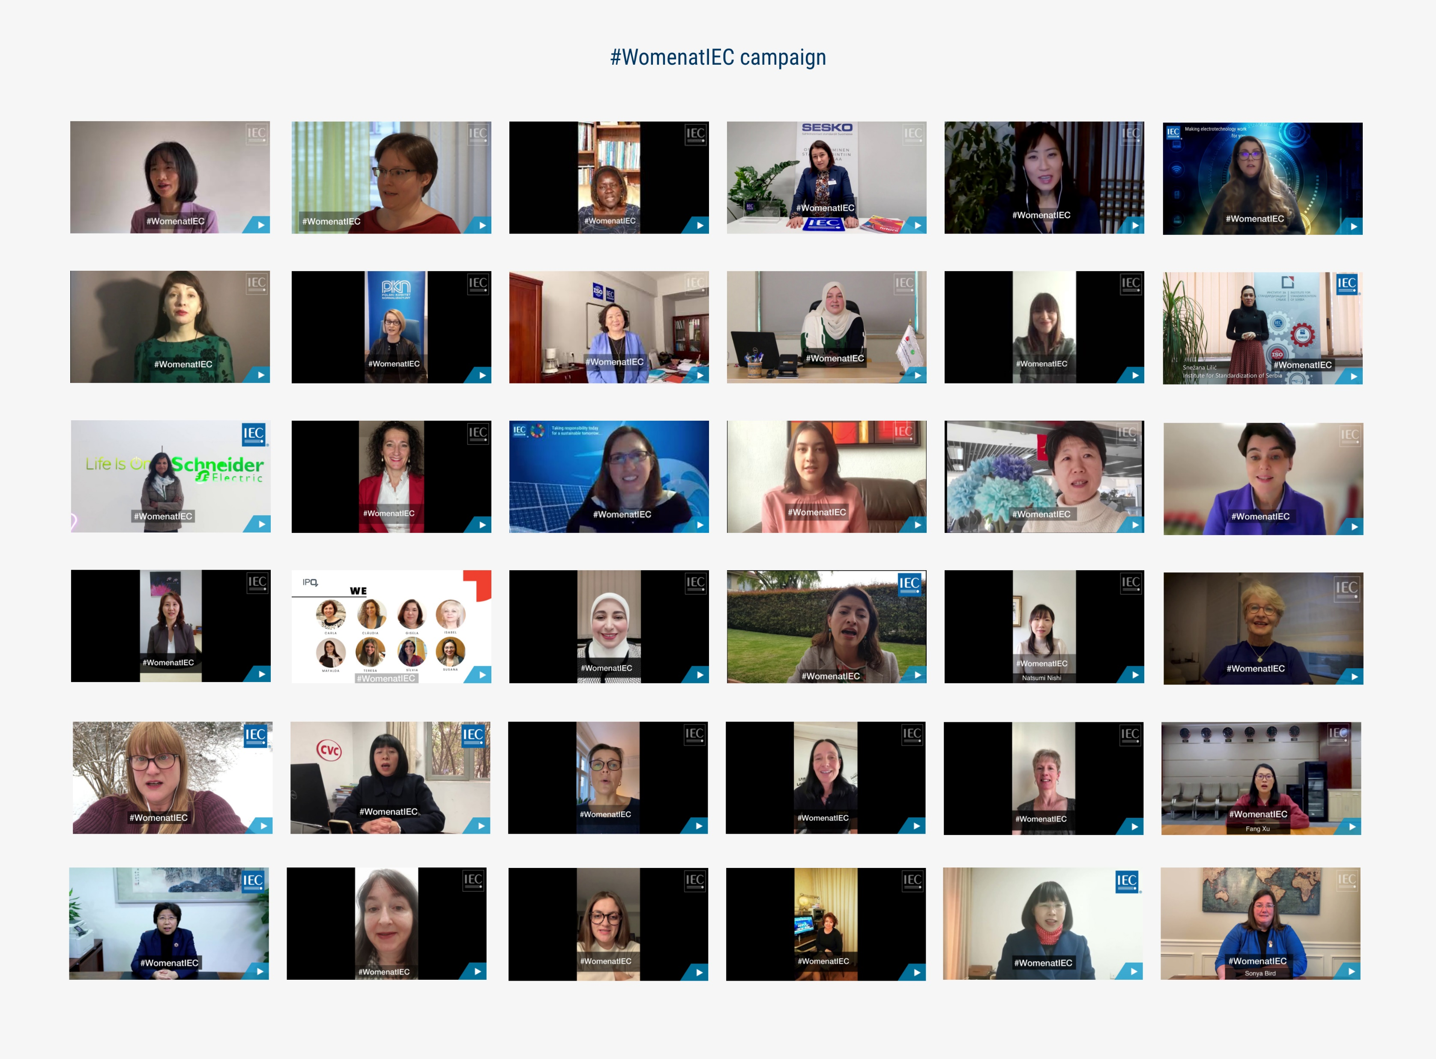

Slide 7
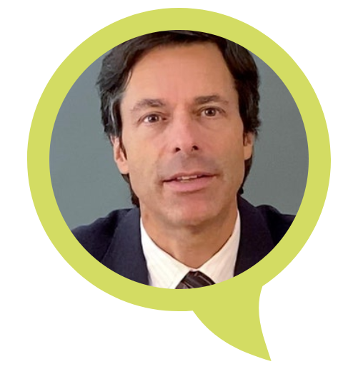
International Gender Champion
Philippe Metzger General Secretary and CEO, International Electrotechnical Commission
Personal Commitments:
Implement internal mechanisms and rules to support an inclusive, enabling and flexible working environment free of discrimination. Train staff and launch the programme.
Conduct a gender-based survey of the renumeration of the IEC staff as regards work of equal value by June 2022 and communicate the findings within the organization by June 2023.

