Slide 1
Digital Product Passport Why, How, When
StandICT event 28 April March, 2023
Ilias IAKOVIDIS
Advisor, Digital aspect of Green Transition,
DG CONNECT, European Commission

Slide 2
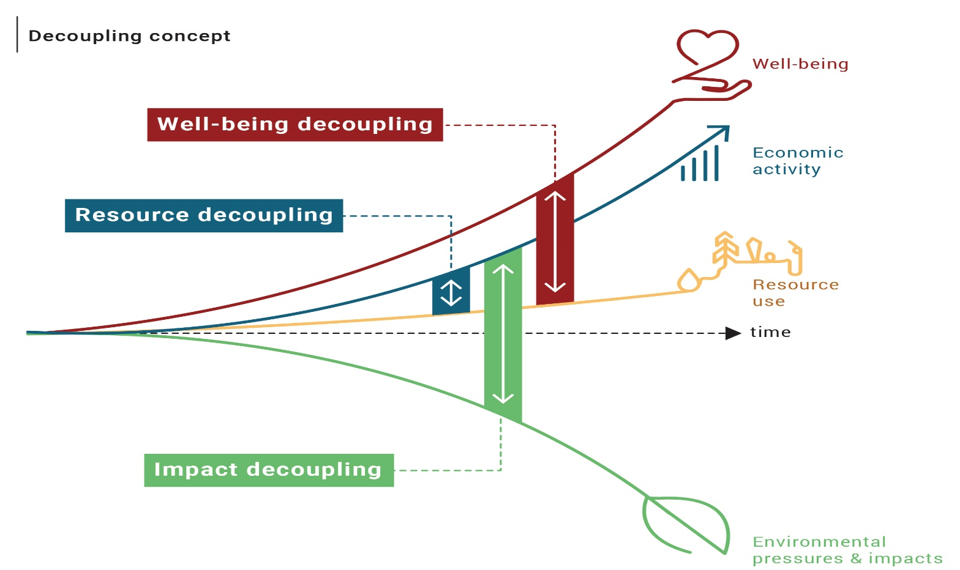
Sustainability is not only about GHG emissions reduction
Key driver Sustainability is not only about GHG emissions reduction

Slide 3
Key tool for Circular Economy: Cooperation & Information exchange
Cooperation among manufacturers, retailers, repairers, recyclers, is essential to enable these ‘circles’

Slide 4
Recent & directly relevant EU legislations:
Ecodesign for sustainable products - European Commission – product requirements, information requirements across who supply chain, Digital Product passport (30.3.2022)
Empowering consumers for the green transition - European Commission (30.3.2022)
Proposal on the Directive on Green Claims ( 22.3.2023)
Proposal for a Directive on common rules promoting the repair of goods ( 22.3.2023)

Slide 5
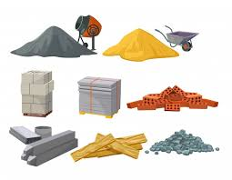
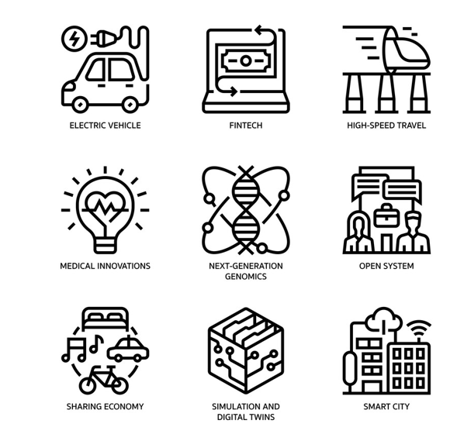
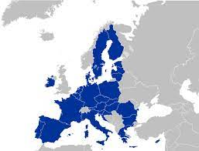
ESPR
Digital Product Passport (DPP) – expected benefits
Tracking of raw materials extraction/production, supporting due diligence efforts
Enable manufacturers to create products digital twins, embedding all the information required
Tracking the life story of a product, enabling services related to its remanufacturing, reparability, re-use/re-sale/second-life, recyclability, new business models
Benefit market surveillance authorities and customs authorities, by making available information they would need to carry out their tasks
Make available to public authorities and policy makers reliable information. Enable to link incentives to sustainability performance
Allow citizens to have access to relevant and verified information related to the characteristics of the products they own or are considering to buy/rent (e.g. using apps able to read the identifier

Slide 6
DPP basic Data Architecture
Offline data
Decentrally stored online data
(Few) centrally stored data
DPP
Public data
DPP registry
PART.A. Cross-sectorial Basic Data Elements
Structured/ Machine readable data
Versioned
Retention period
All data carriers
PART.B. Links to DPP
All product unique identifiers
Restricted data
PART.C. Control Data Elements
The information that allows the verification of the authenticity of the DPP
Counterfeiting info
Data Carrier

Slide 7
DPP design
DPP-system
DPP-data
(to be developed before DPP deployment)
Digital Product Passport
(to be identified when developing product-group specific secondary legislation)
Possible Track & Trace identifiers
All standards and protocols related to the IT architecture, like standards on:
Data carriers and unique identifiers
Access rights management
Interoperability (technical, semantic, organisation), including data exchange protocols and formats
Data storage
Data processing (introduction, modification, update)
Data authentication, reliability, and integrity
Data security and privacy
The DPP registry
Economic operator’s name, registered trade name
Global Trade Identification Number or equivalent
TARIC code
Global location number
Authorised representative
Reference of the back-up data repository
…
Example of potential attributes
Description of the material, component, or product
Recycled content
Substances of concern
Environmental footprint profile
Classes of performance
Technical parameters
…

Slide 8
Standardisation Request
The scope and legal requirements
Basis for future harmonised standards
8 new areas of harmonised standards to be drafted to support the implementation of the proposed DPP-system. In particular:
Unique identifiers
Data carriers
Links between physical product and digital representation, including look-up mechanism
Access rights management
interoperability (technical, semantic, organisation), including data exchange protocols and formats and data processing (introduction, modification, update)
Data authentication, reliability, integrity
Data security and privacy

