Slide 1
Blockchain Standards in IEEE
Data Management, Digital Asset, and Applications

Slide 2
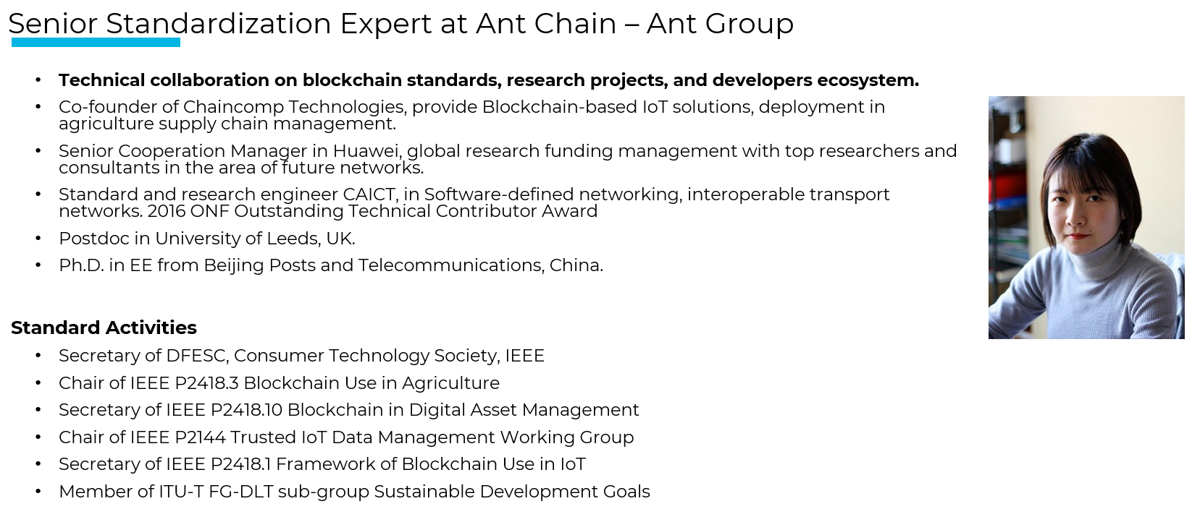
About me
Hui Ding, Ph.D.
dinghui.ei@gmail.com

Slide 3
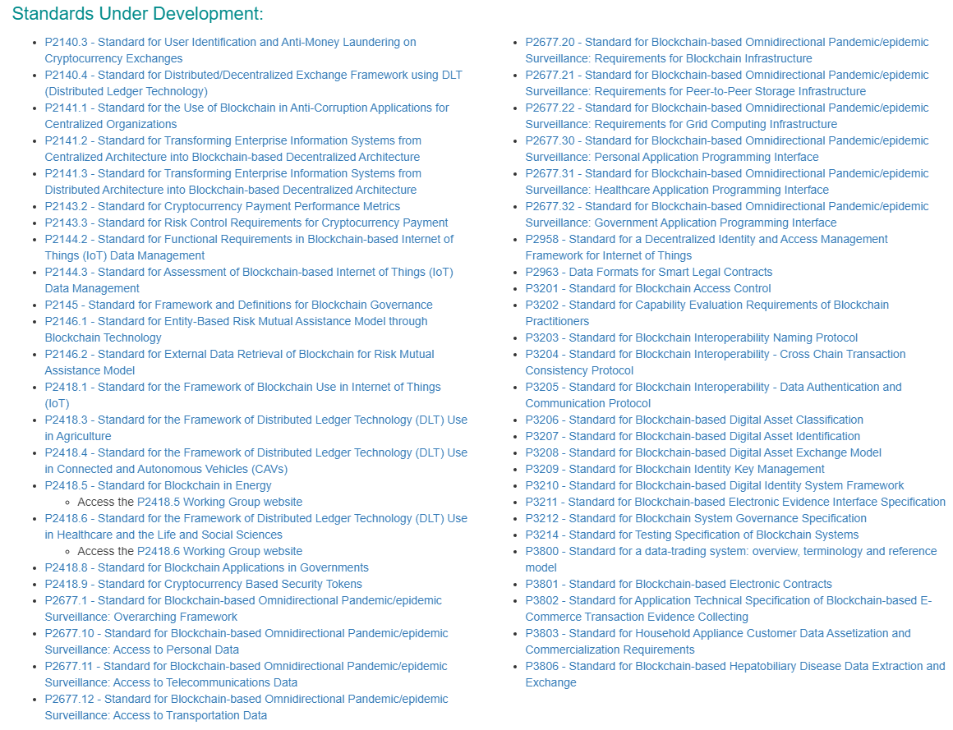
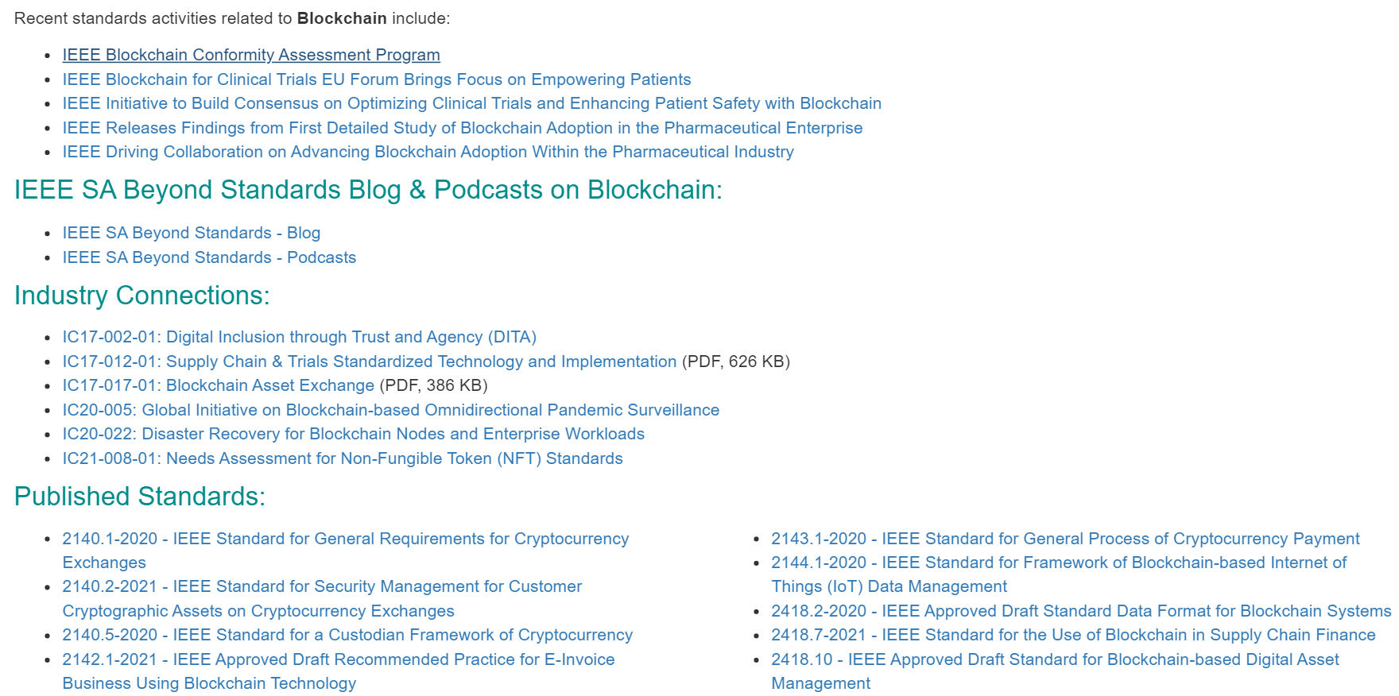
IEEE-SA Blockchain Standards
Industry Connections
Seminars & Conferences
Standards
Computer Society
Communication Society
Consumer Technology Society

Slide 4
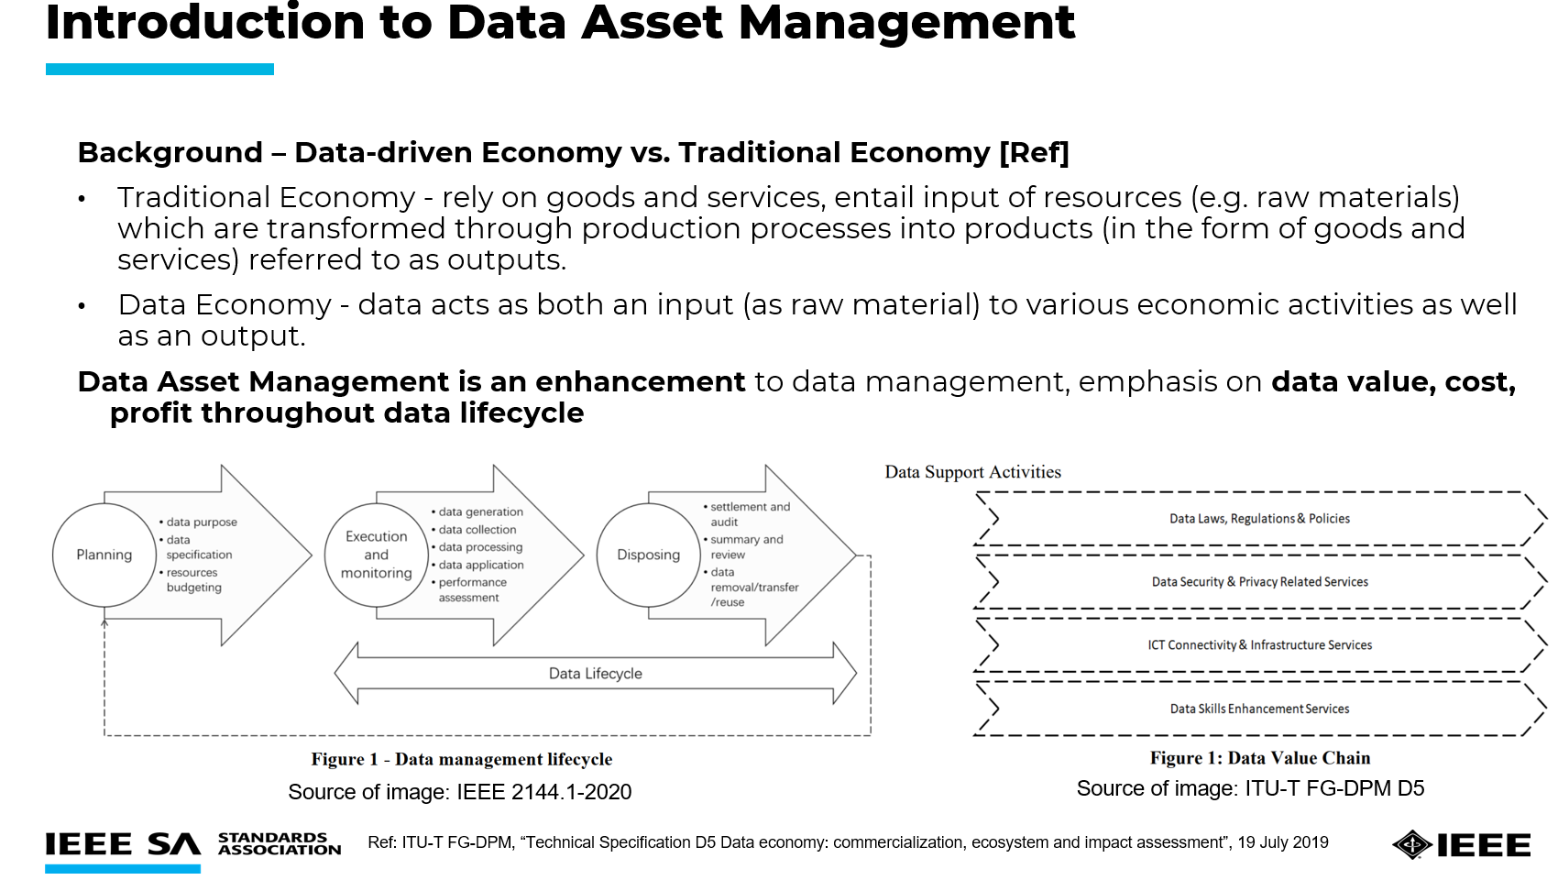
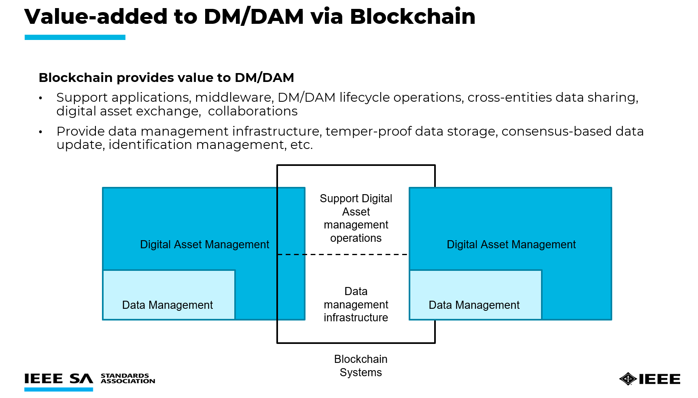
Examples of Blockchain standards on Data & Digital Asset Management
2144.1-2020 - IEEE Standard for Framework of Blockchain-based Internet of Things (IoT) Data Management
2418.10 - IEEE Approved Draft Standard for Blockchain-based Digital Asset Management

Slide 5
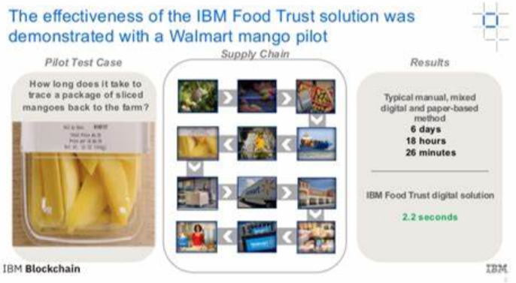
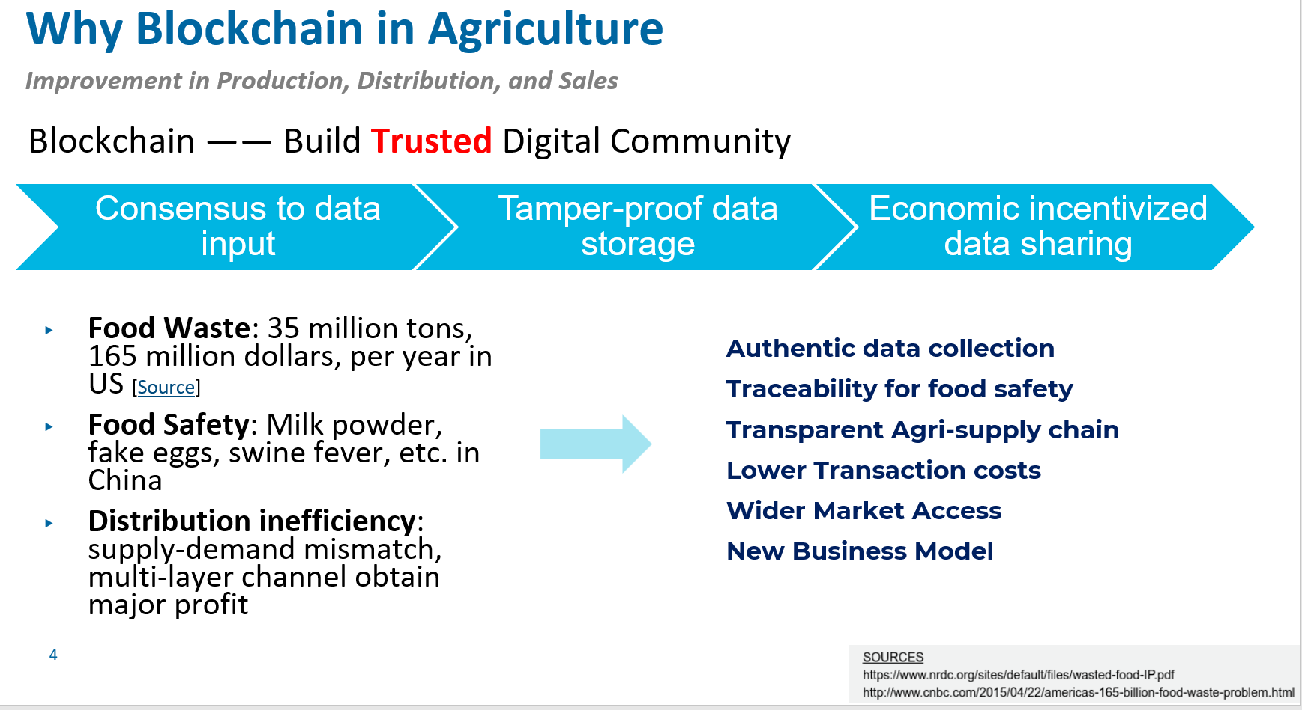
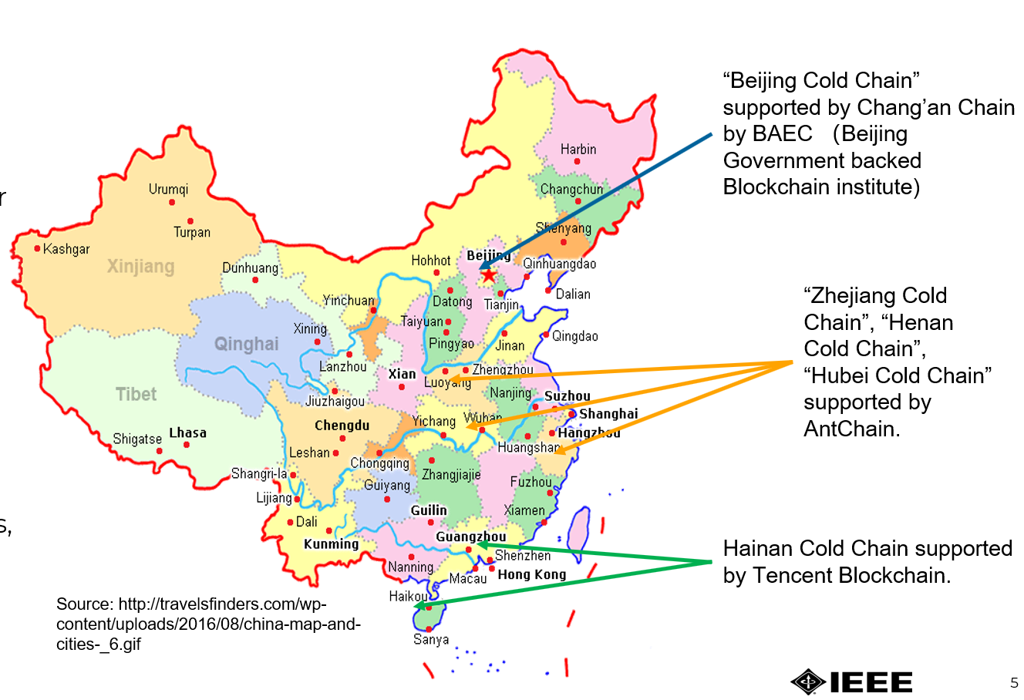
IEEE P2418.3 WG (in progress)
Application of Blockchain in Agriculture
Use Case – Frozen food tracking for COVID-19 detection and prevention

Slide 6
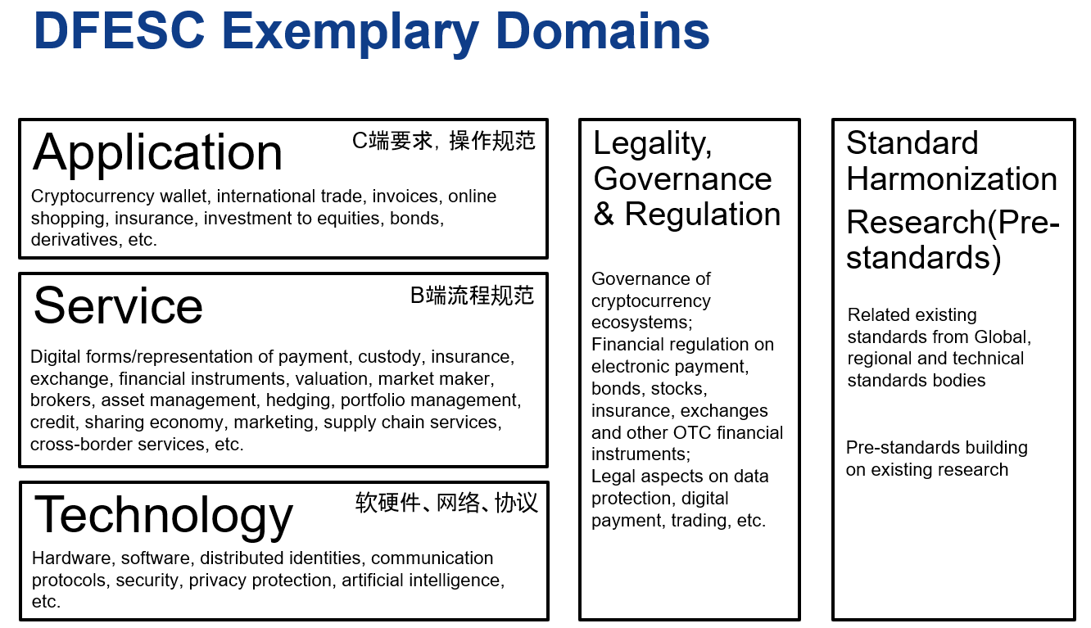
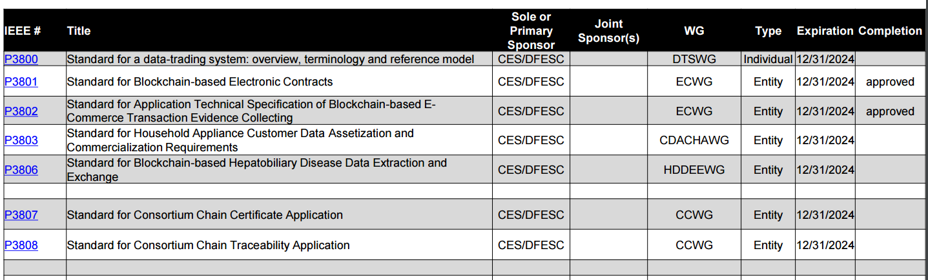
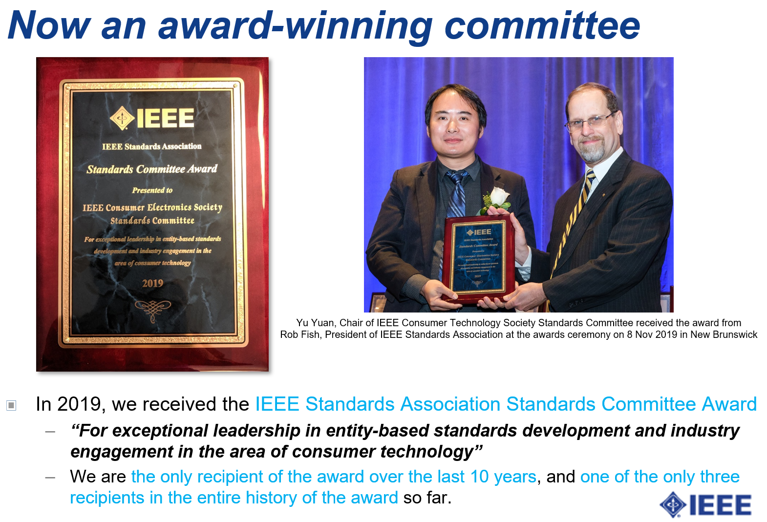
IEEE DFESC Activities
Standard Committee of Consumer Technology Society received IEEE-SA award in 2019 (left picture)
On March 5th, 2020, IEEE SA formally approved the establishment of the Digital Finance and Economy Standards Committee (DFESC)
CONTACT US if you’re interested in participation!

