Slide 1
CEN-CENELEC Focus Group on Quantum Technologies (Standardization and Innovation)
Nooshin Amirifar, Project Manager at CEN & CENELEC

Slide 2
Standardization happens on different levels
National
European
International
CEN & CENELEC have a network of 43 members within 34 countries
Officially recognised in the EU Regulation 1025/2012
1 standard for all CEN & CENELEC members ‘Stand Still Rule’!

Slide 3
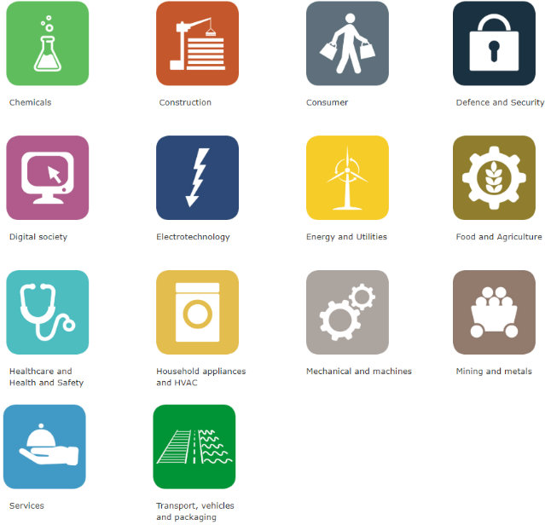
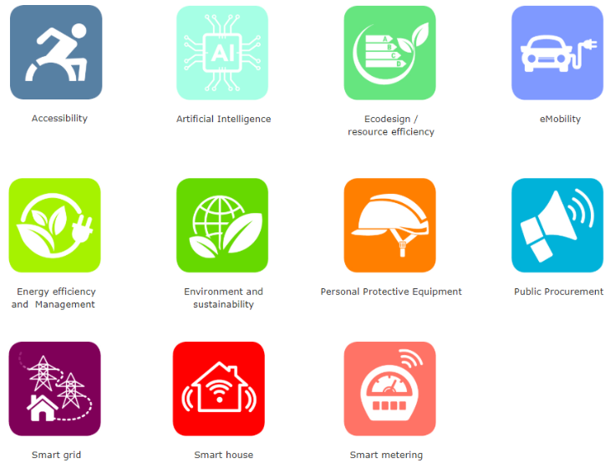
CEN & CENELEC at a glance
14
Business sectors
11
Business topics
450
Technical Committees
1.800
Working Groups
200.000
Experts
~24.000
Standards
(nearly 5.000 HS)
>700
Technical Specifications
~900
Technical Reports
500
CWAs

Slide 4
Role of European standards
European standards
At the heart of the new sustainable and digital economy
Key role in implementation of European legislations
Allowing manufacturer to benefit from the ‘presumption of conformity’ (European harmonized standards)
Supporting ‘European single market’
Supporting European strategies and priorities
It is important for the European standardization system to be able to respond to the European urgencies and priorities
and to foresee the future market needs alongside the innovation
A need for CEN & CENELEC to create a platform addressing the future standardization opportunities related to the Quantum technologies

Slide 5
CEN & CENELEC activities in Quantum Technologies
CEN-CLC Focus group on Quantum technologies (FGQT) created on May 2020:
150+ delegates, 25+ meetings, 220+ contributions
a platform for an active dialogue among the European (and international) actors active in the field of QT
providing a European standardization roadmap on QT: the current needs and future standardization opportunities in Europe
NEW CEN & CENELEC Joint Technical Committee ‘Quantum Technologies’
CEN-CLC JTC 22 will address the standardization opportunities in Europe as well as close cooperation with the CEN & CLC international counterparts.
CEN-CLC FGQT Kick off meeting
June 2020
Developing a European standardization roadmap (140+ page)
Q4 2022-Q1 2023
First release of roadmap
Dec 202-Jan 2023
Standardization activities within the newly establish CEN-CLC joint technical committee

Slide 6
How the new CEN-CLC JTC can support innovation in different aspects of the QT?
Standards can be beneficial at all stages of technology readiness level
Knowledge development
Technology development
Business development
TRL 1
TRL 2
TRL 3
TRL 4
TRL 5
TRL 6
TRL 7
TRL 8
TRL 9
Basic research
Applied research
Experimental development
Market launch & commercialization
Semantic standards
Facilitate efficient communication in basic research investigating new technologies
Measurement & testing standards
Allow progress towards first product-related development
Interface standards
Allow interoperability of components integrated into the product or process technology
Product & service
specific standards
Define the characteristics of a product/service and their performance thresholds (such as quality and safety)

Slide 7
Thank you!
Nooshin Amirifar
Project Manager of CEN & CENELEC Focus Group on Quantum Technologies
namirifar@cencenelec.eu
Quantum Technologies - CEN-CENELEC (cencenelec.eu)

Slide 8
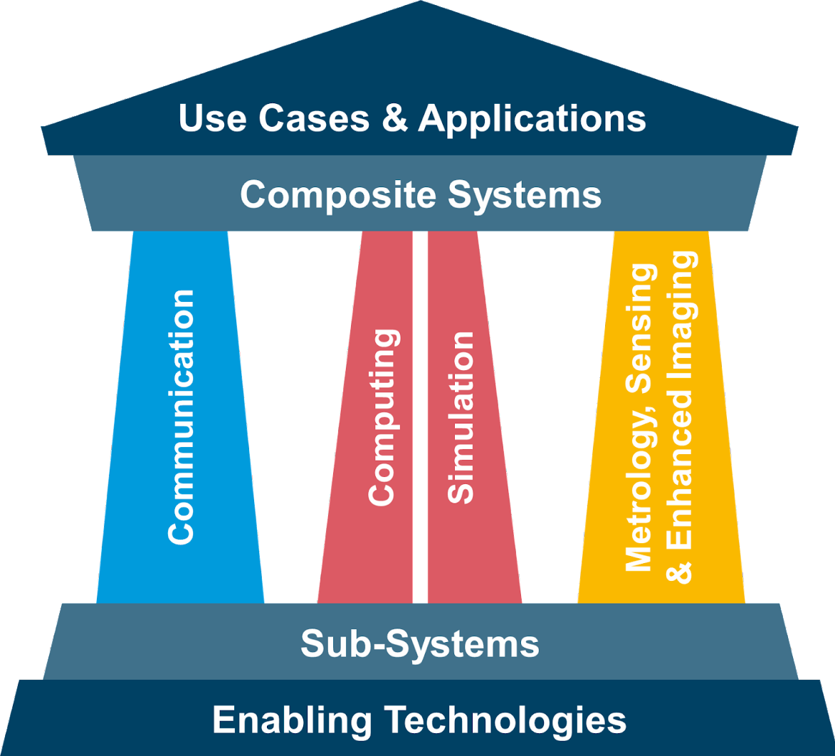
CEN-CLC FGQT roadmap

